Slide 1
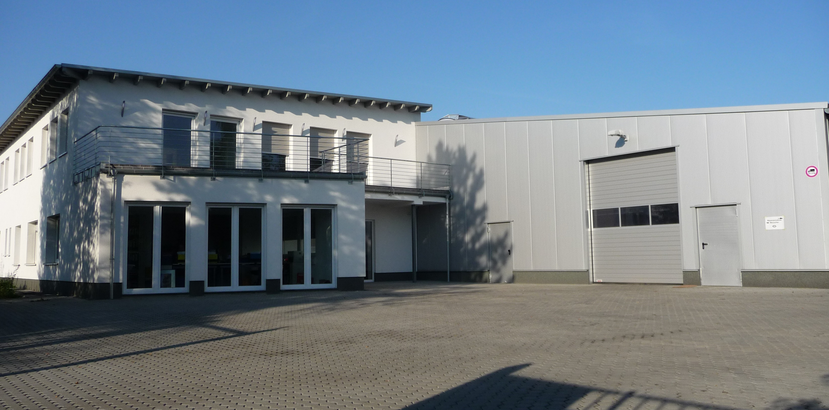
SERVICES
LEARN MORE ABOUT
OUR SERVICES FOR YOU

Slide 2
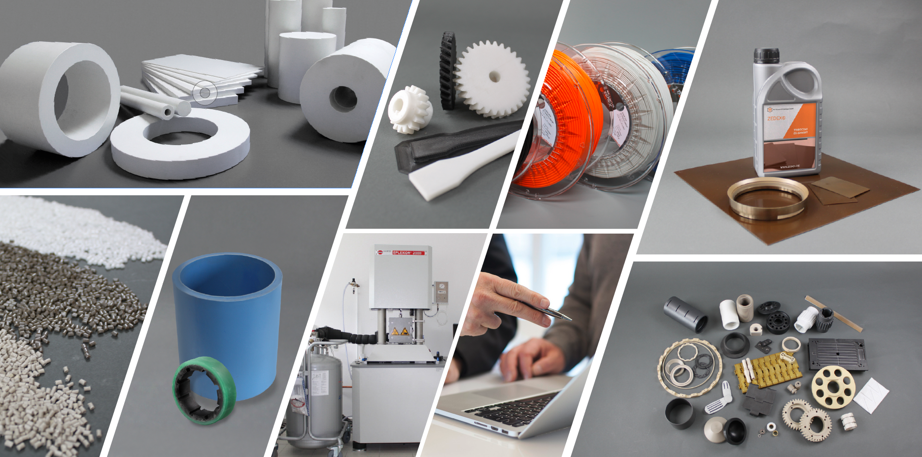
UNSERE PRODUKTE
Semi-finished Products
Platte, Stäbe, Rohre
Granulate
Standard- und Spezialmischungen
3D Druck
Standard- und kundenspezifische Teile
3D Druck
Filamente / Tribofilamente
Tribo-Coating
Beschichtungen und beschichtete Teile
Laborprüfungen
Forschung, Entwicklung und Analyse
Pumpen & Schiffbau
Gleitlager
Consulting
We deliver solutions
Fertigteile
Standard- und kundenspezifische Teile

Slide 3

OUT SERVICES AND SUPPORT
POLYMER TESTING, EVOLUTION, DAMAGE ANALYSIS
POLYMER PARTS DESIGN
Polymer testing, failure analysis
Compound development
Consulting, calculation
Design
ONLINE SERVICE
Calculation-tools
Online Warehouse
Online Shop

Slide 4
CONSULTING
ASSISTANCE WITH
PROBLEM ANALYSIS
CORE AREAS
  personal consulting on site
  telephone support
  Analysis by questionnaires
  Materials Consulting
    Plastics and high-performance plastics
  Component advice
    Plain bearings, also hydrodynamic
    Spindle nuts
    Track rollers
    Gears
    Sliding and wearing elements
Consulting

Slide 5







CONSULTING
By phone
Available during our business hours
In written form
We will process your request as
soon as possible.
In person
We will be happy to advise you on site.
Trainings
For the optimal know-how
Professional consulting
is a matter of course for us
Support from
problem analysis to solution
Delivery of new
problem-free components
Consulting
We are here for you in different languages!

Slide 6
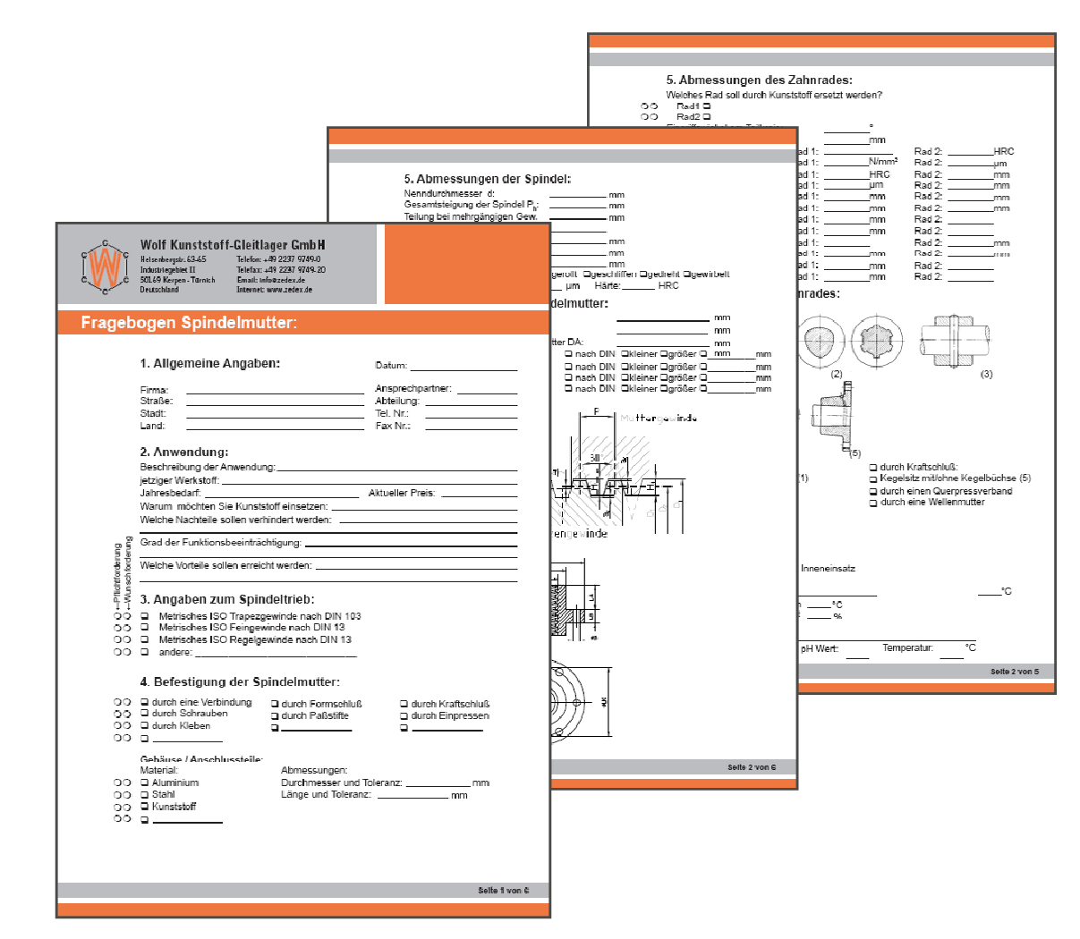
QUESTIONNAIRES TO FIND THE OPTIMAL MATERIAL
With the help of our questionnaires you can also give us your application data in advance.
We then select the suitable plastic for you and support you in the realization of your
project.
Consulting
Notes:
a possibility to describe technical problems is the q.
we use the to select materials for the customer

Slide 7
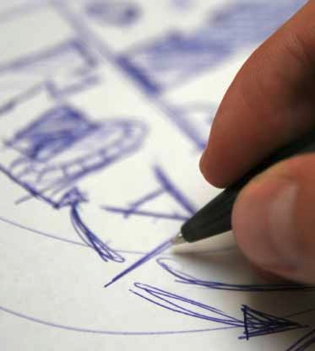
CALCULATION & DESIGN
Calculation (static, dynamic, thermal, tribological)
Material selection
Component design
Construction suitable for processing
(Consideration of the production process in design)
Designing to suit the material
(Consideration of the properties of the plastic)
Clarification of optimal design, service life and performance
Execution of necessary calculations
Calculation & Design

Slide 8
CALCULATION & DESIGN
Specification of the production process
Consideration of the property change
Courses and information
Calculation software for our customers
Calculation & Design

Slide 9
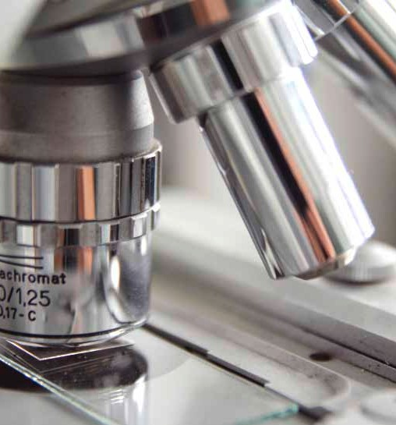
RESEARCH, DEVELOPMENT & MATERIAL ANALYSIS
Damage analysis
thermal, mechanical, electrical testing
Customer-specific component testing incl. report
Compound development
Adding modifications
Fundamental research
Intensive basic research and material development
are fundamentals of our success
Benefit from many testing possibilities of our in-house
laboratory
Research, Development & Materials Analysis

Slide 10

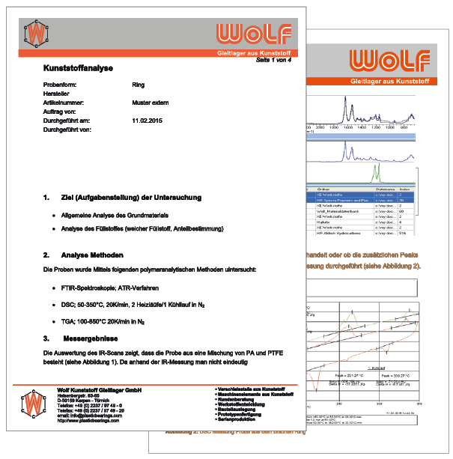
TRIBOLOGICAL POLYMER TESTING, EVOLUTION AND DAMAGE ANALYSIS
MATERIAL TESTING BROCHURE
TEST REPORTS
Research, Development & Materials Analysis
Notes:
we also do these tests as a service, e.g. mitusi
this document lists all the tests we carry out, richt sample of a test report

Slide 11
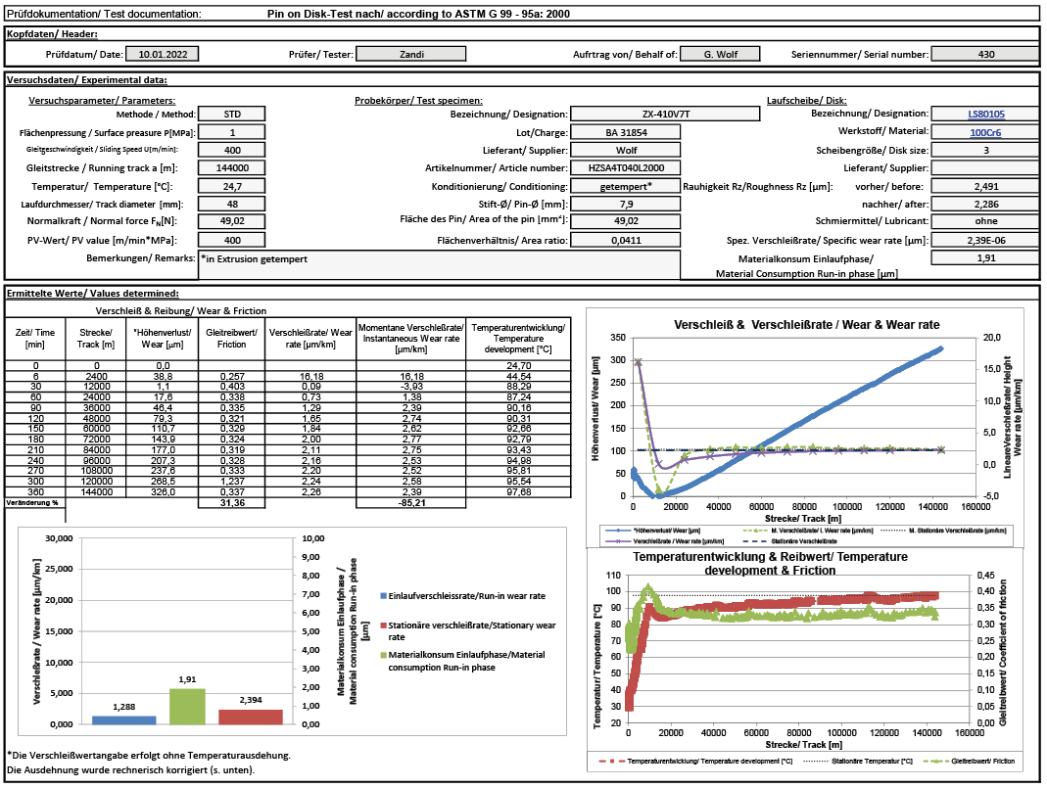
TRIBOLOGICAL POLYMER SOLUTIONS
Research, Development & Materials Analysis
Notes:
example for a tribo report, friction and wear is our core competence

Slide 12
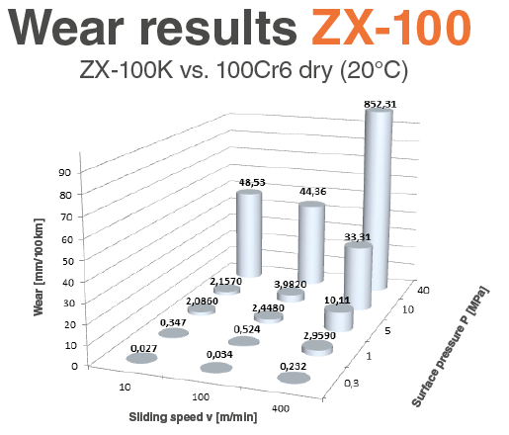
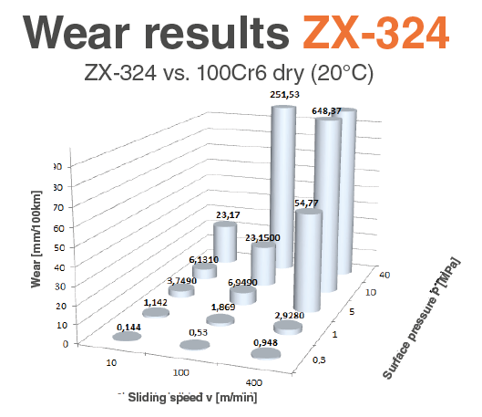
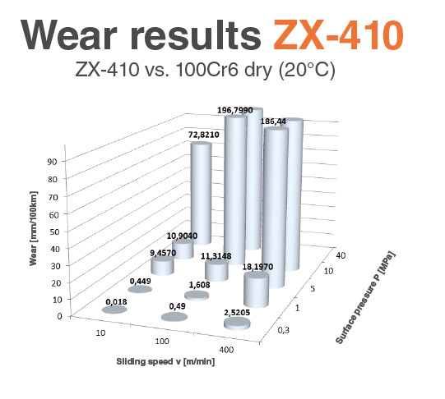
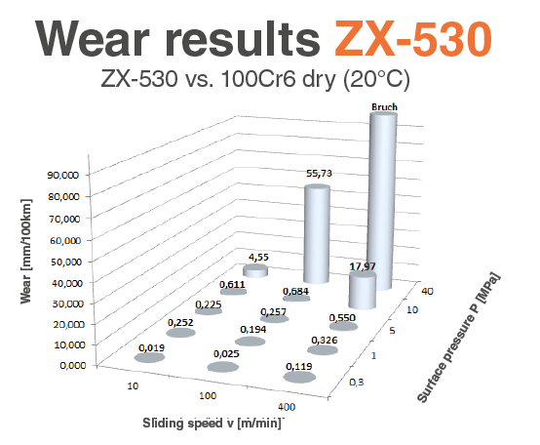
MATERIAL FAMILIES
Research, Development & Materials Analysis
Notes:
these are the results of numerous tribo tests
the higher the column, the higher the wear.
Peek is much worse than 100 or 530. and PEEK costs much more
this knowledge helps with sales and increases the value of the product and the price

Slide 13
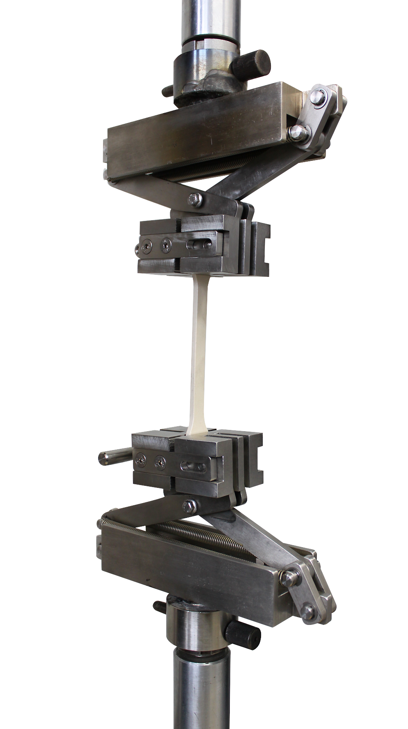
DAMAGE ANALYSIS
MECHANICAL, THERMAL, MICRO, MACROSCOPIC
Tribological polymer testing, evolution and damage analysis
MATERIAL TESTING
To develop a new material or to further develop or modify existing materials, a large number of laboratory to attempt.
Due to our extensive laboratory equipment and decades of experience, we are able to carry out all relevant tests ourselves and use the data collected as a basis for further developments.
Mechanical testing
Thermal Analyzes
Tribological examinations
Electrical tests
Component tests on the test bench
Customized trials
Research, Development & Materials Analysis
Notes:
one of our services
in our laboratory we use all important methods including triobology tests

Slide 14
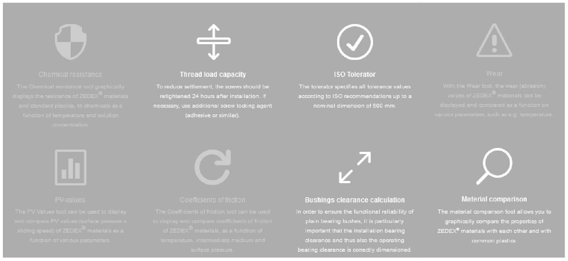
CALCULATION TOOLS
On our website we offer various calculation tools. e.g. ISO Tolerator, thread load capacity, bushing clearance calculation, material comparison and more.
Research, Development & Materials Analysis
Notes:
or the customer selects the material using our online tools

Slide 15
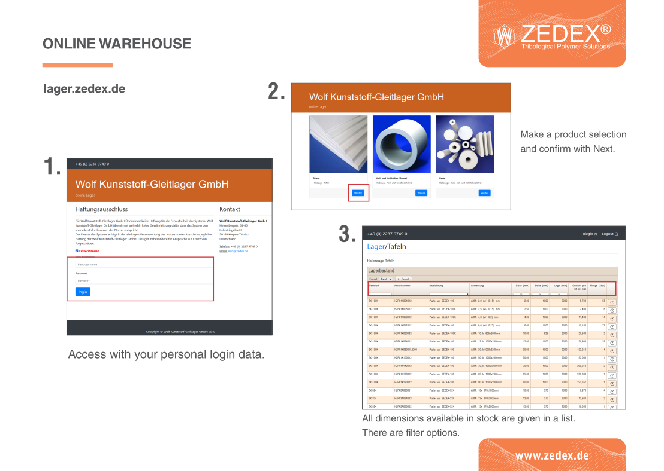
2.
MAKE A PRODUCT SELECTION AND CONFIRM WITH NEXT
1.
3.
ACCESS WITH
YOUR PERSONAL LOGIN DATA.
ALL DIMENSIONS AVAILABLE IN STOCK ARE GIVEN IN A LIST.
ONLINE SERVICES
Notes:
With this tool, the stock can be displayed online
and soon the delivery time for products to be produced can also be determined

Slide 16
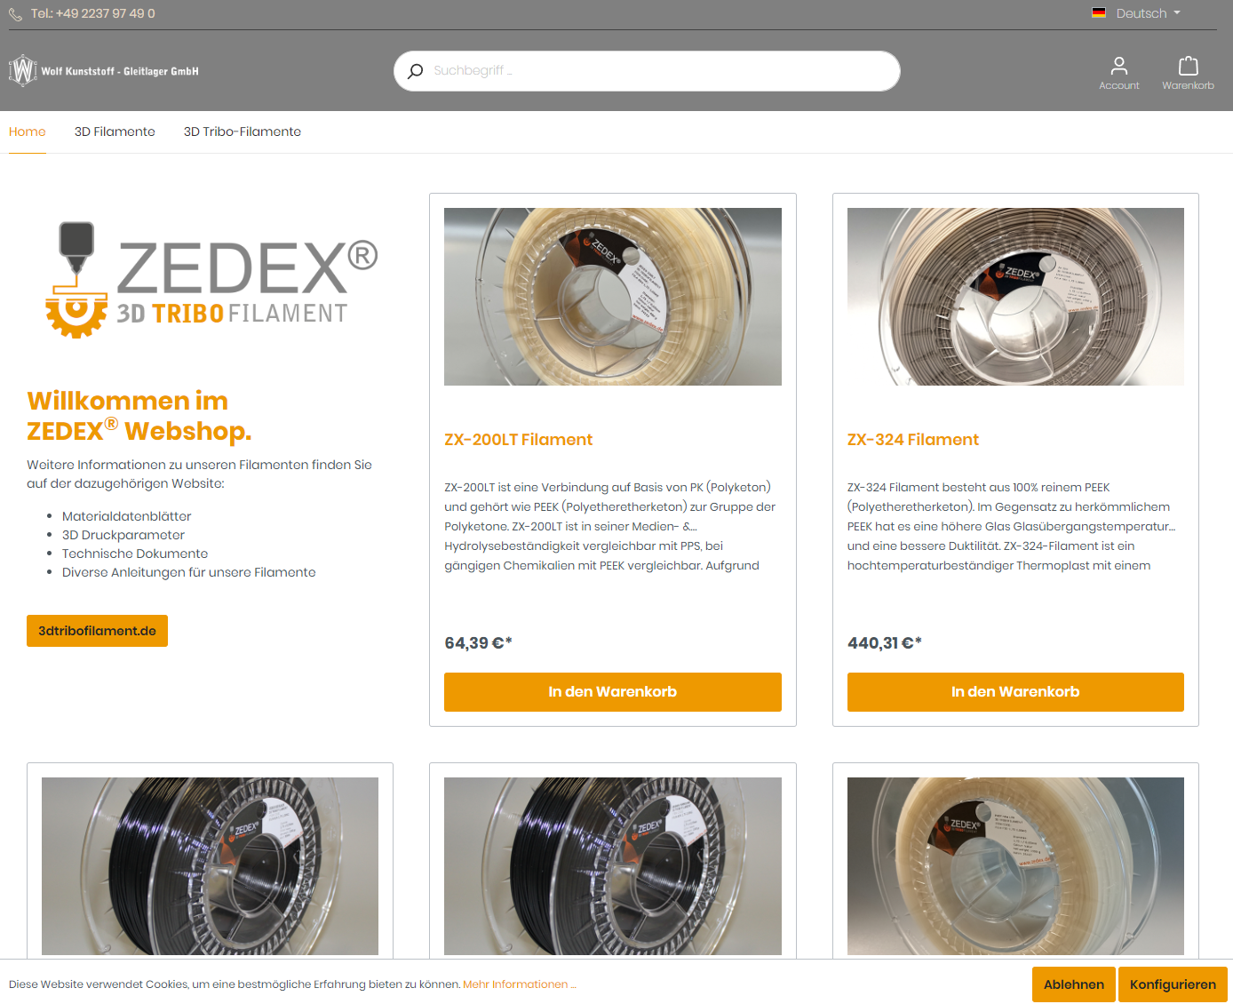
ONLINE SERVICES
Notes:
With this tool, the stock can be displayed online
and soon the delivery time for products to be produced can also be determined

Slide 17
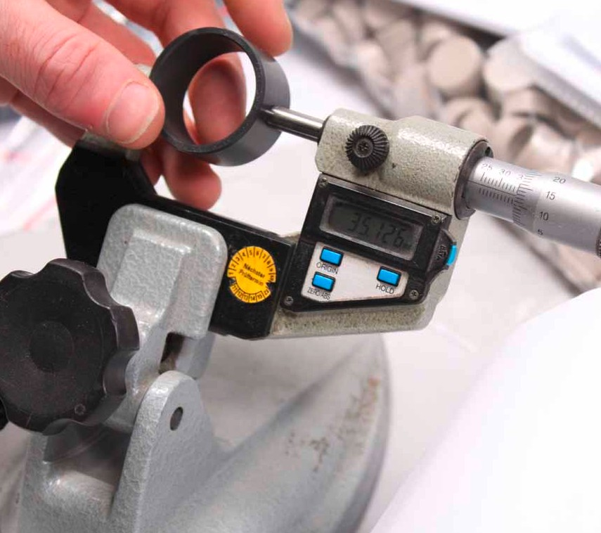

QUALITY ASSURANCE
Testing in our company
Highest quality standards, with regularly maintained testing equipment
All checks, final inspections and approvals are controlled from Germany, also for foreign productions.
Many leading customers from a wide range of industries rely on our quality.
QUALITY ASSURANCE

