Slide 1
OUR MISSION
FUN AND PASSION IN THE DEVELOPMENT OF BETTER HIGH PERFORMANCE PLASTICS FOR SLIDING ELEMENTS

Slide 2
OUR GOAL
WE WANT EVERYONE TO NOW THAT WE OFFER THE BEST HIGH PERFORMANCE PLASTIC SLIDING ELEMENTS

Slide 3
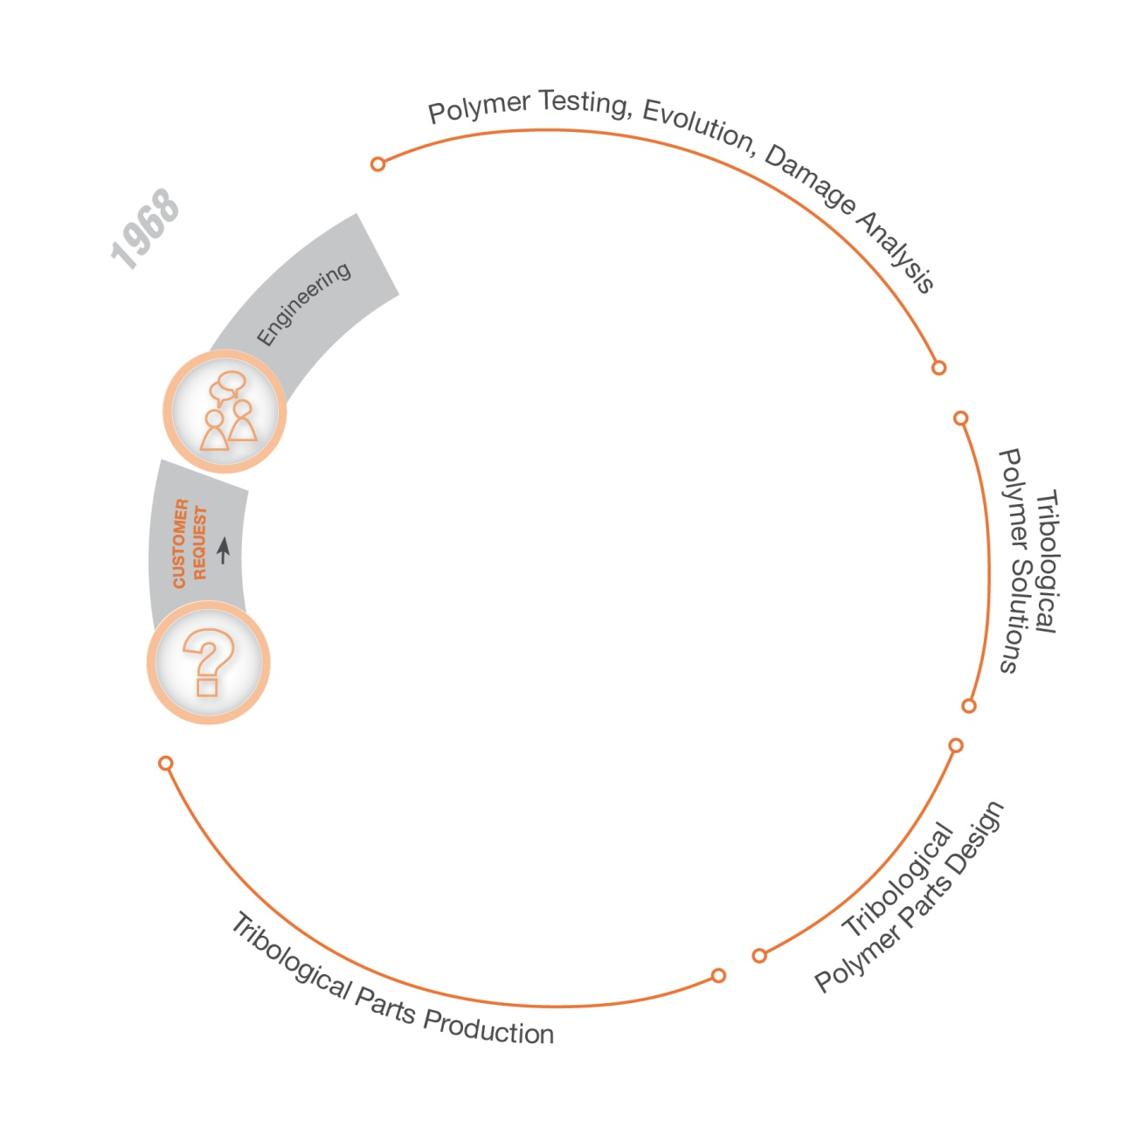
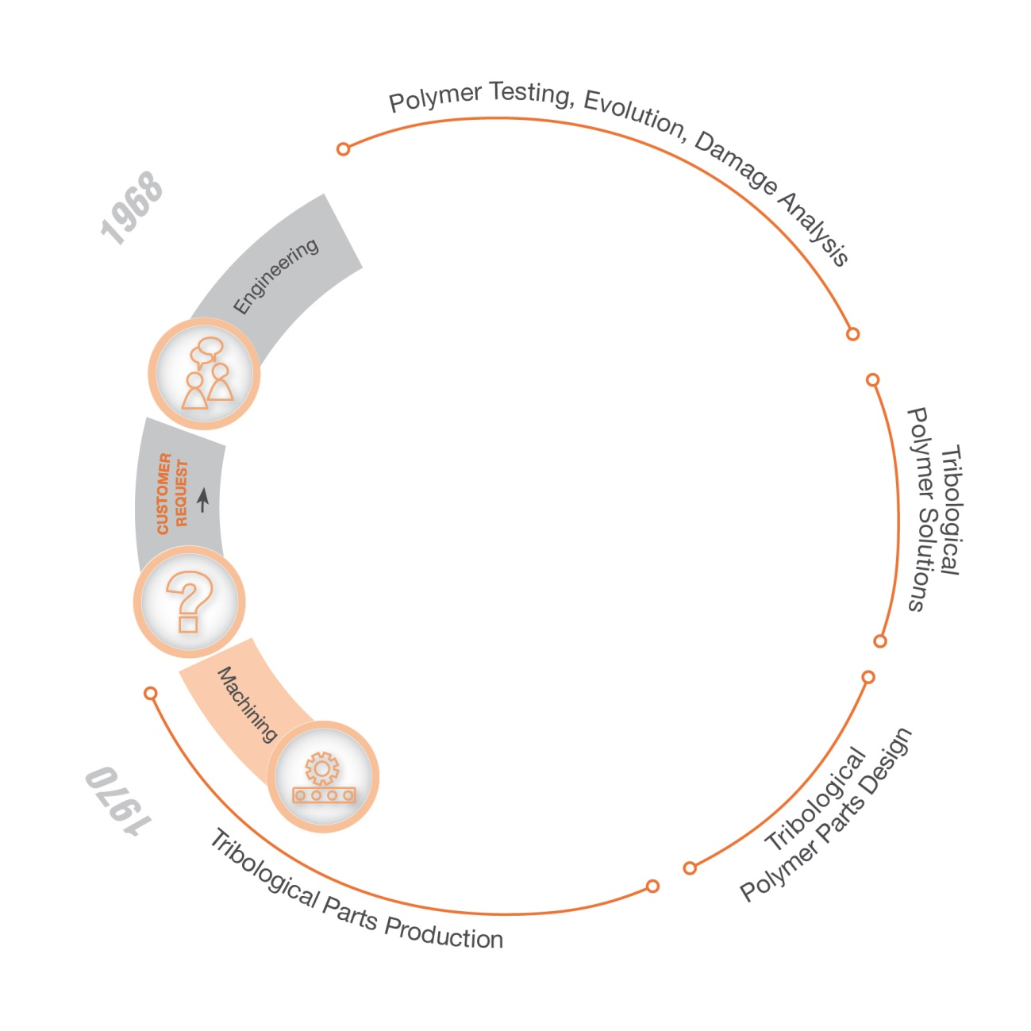
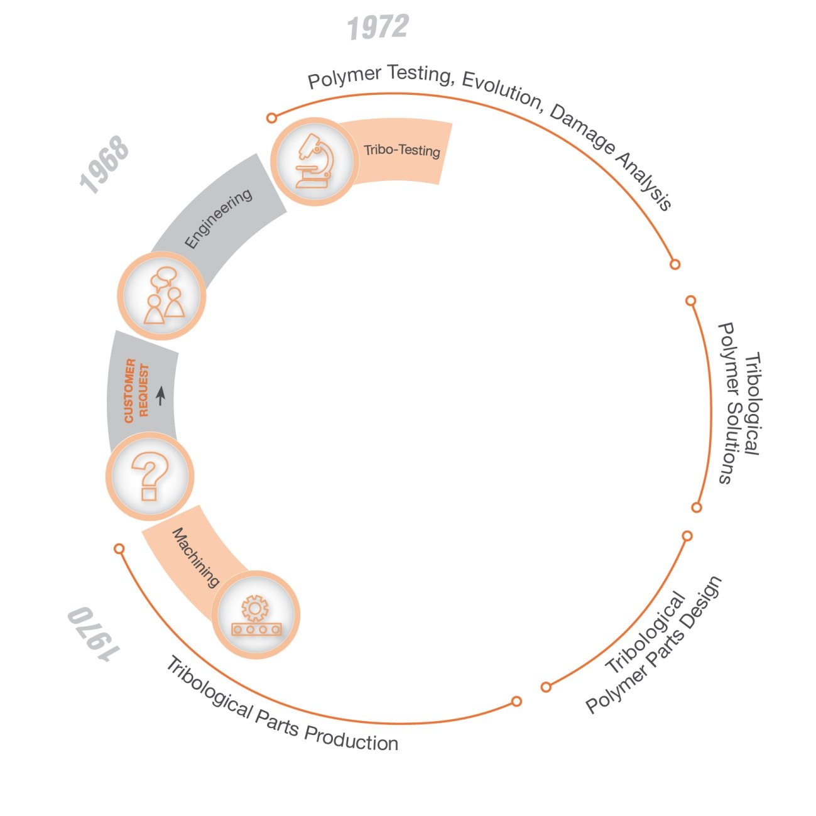
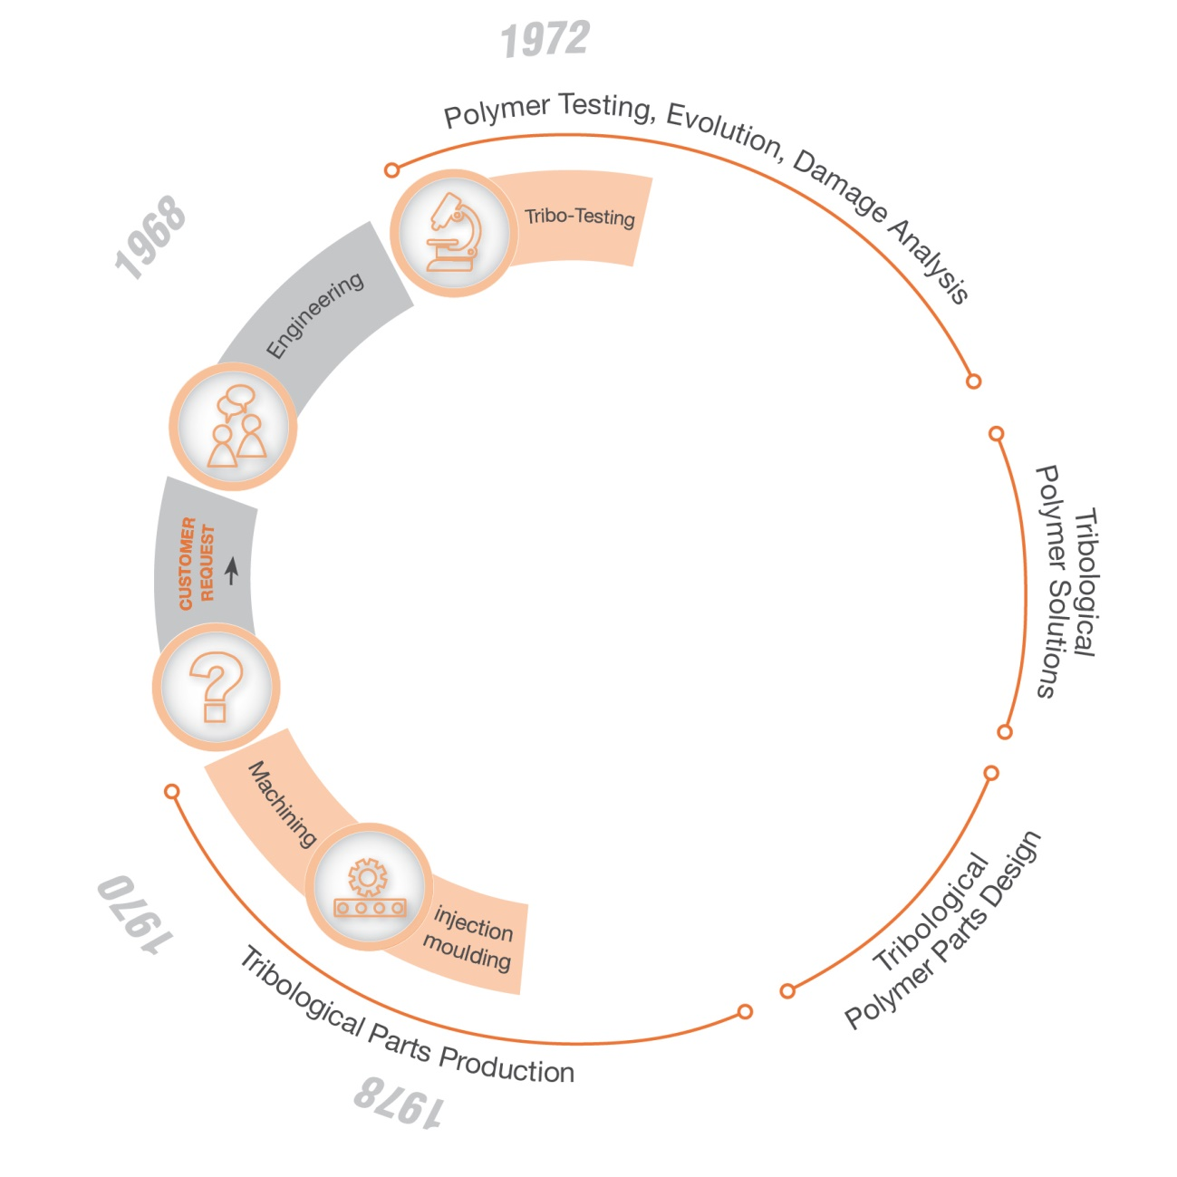
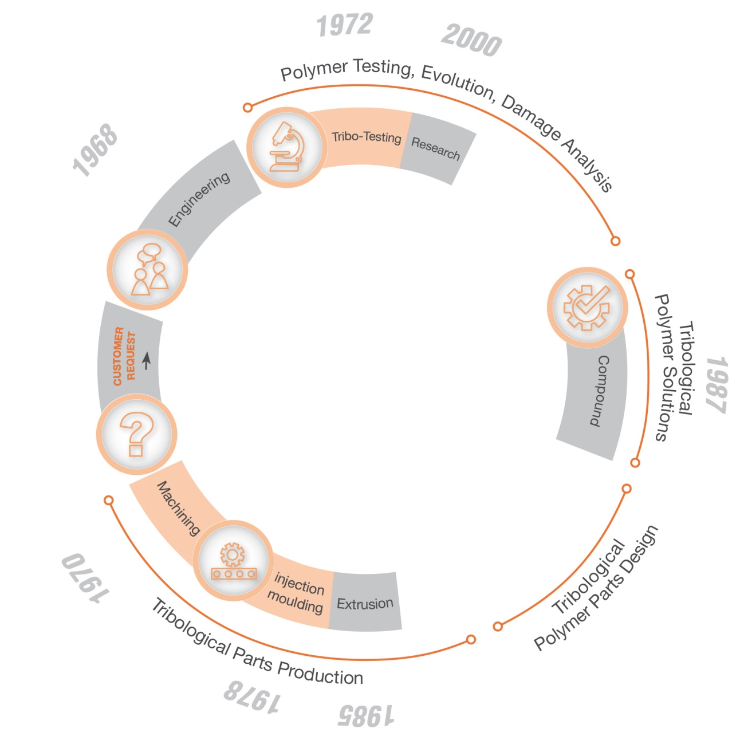
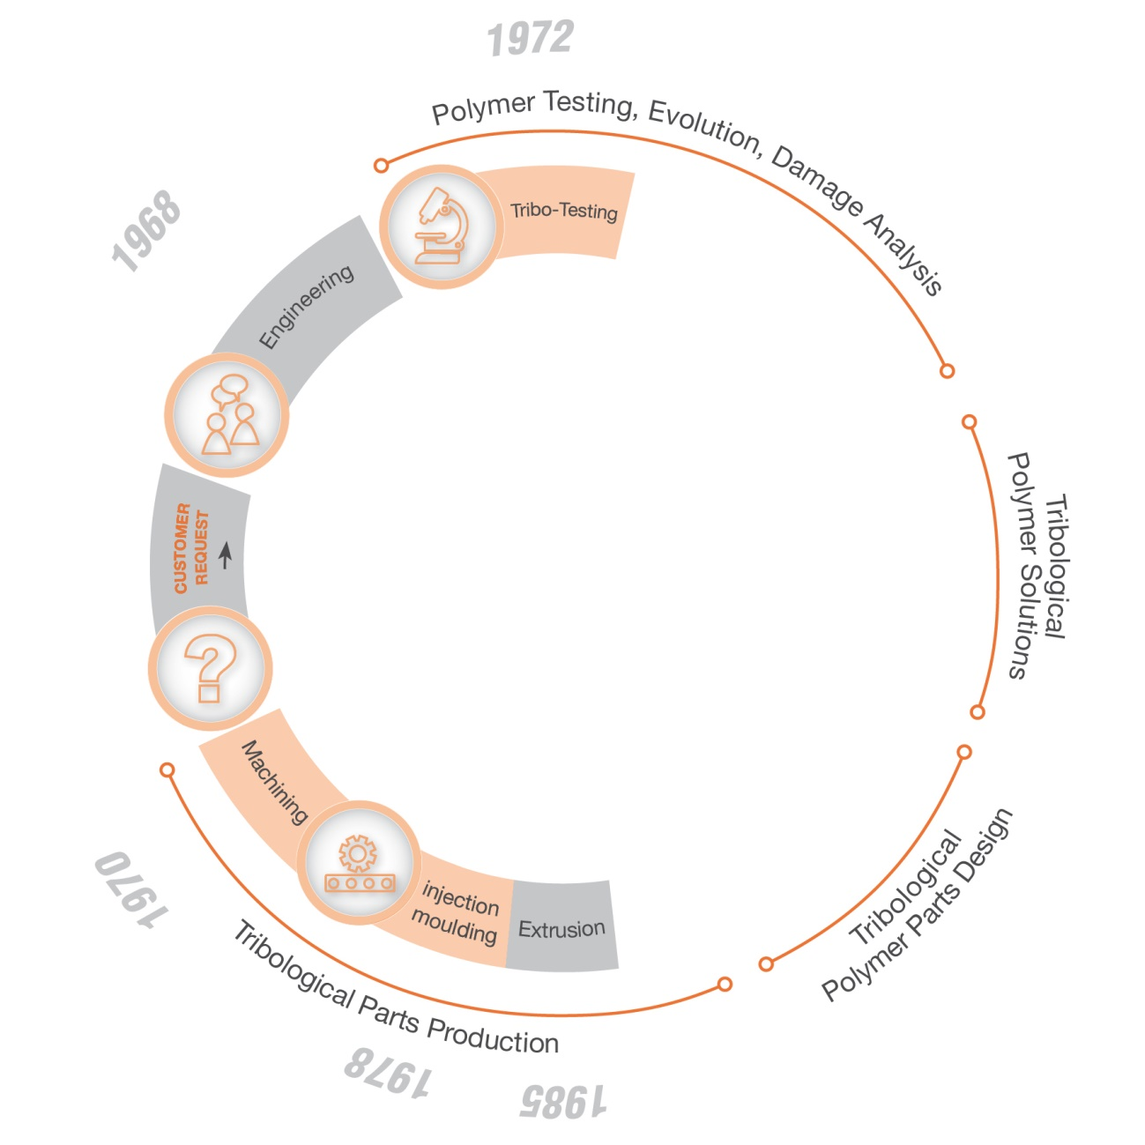
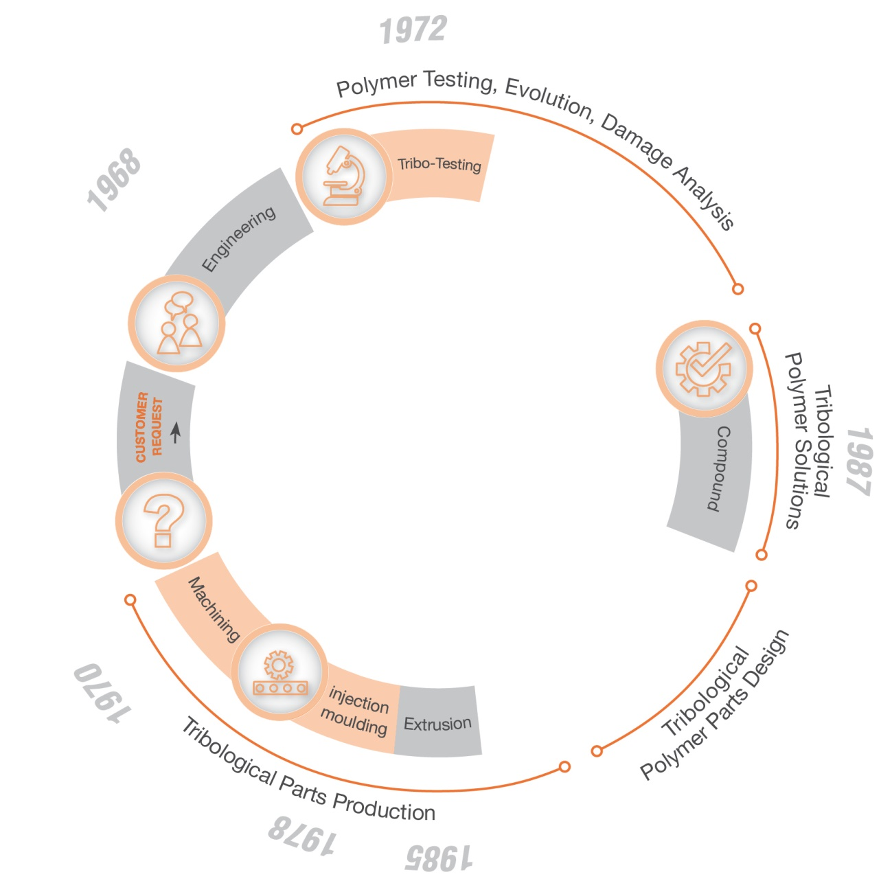
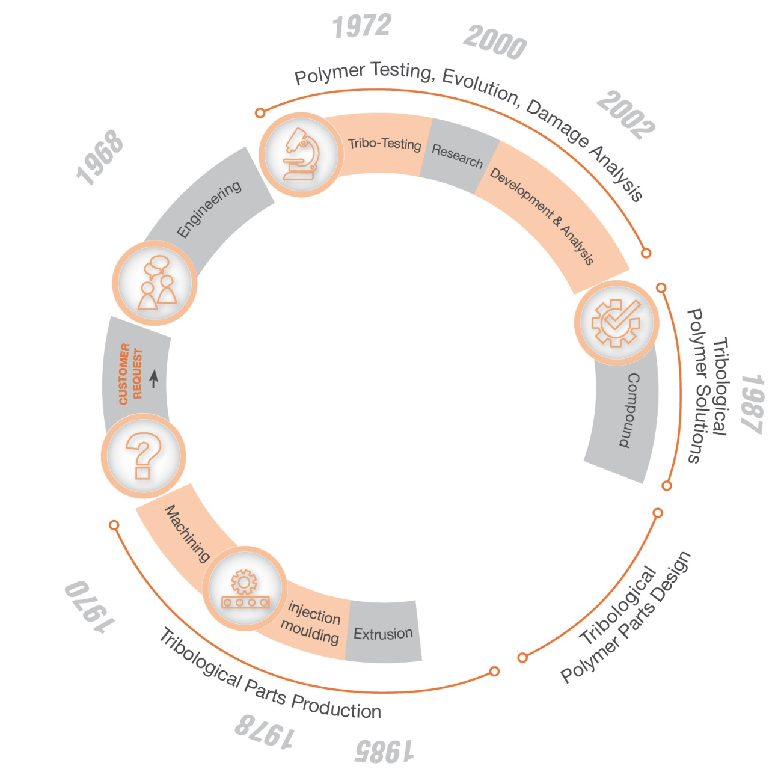
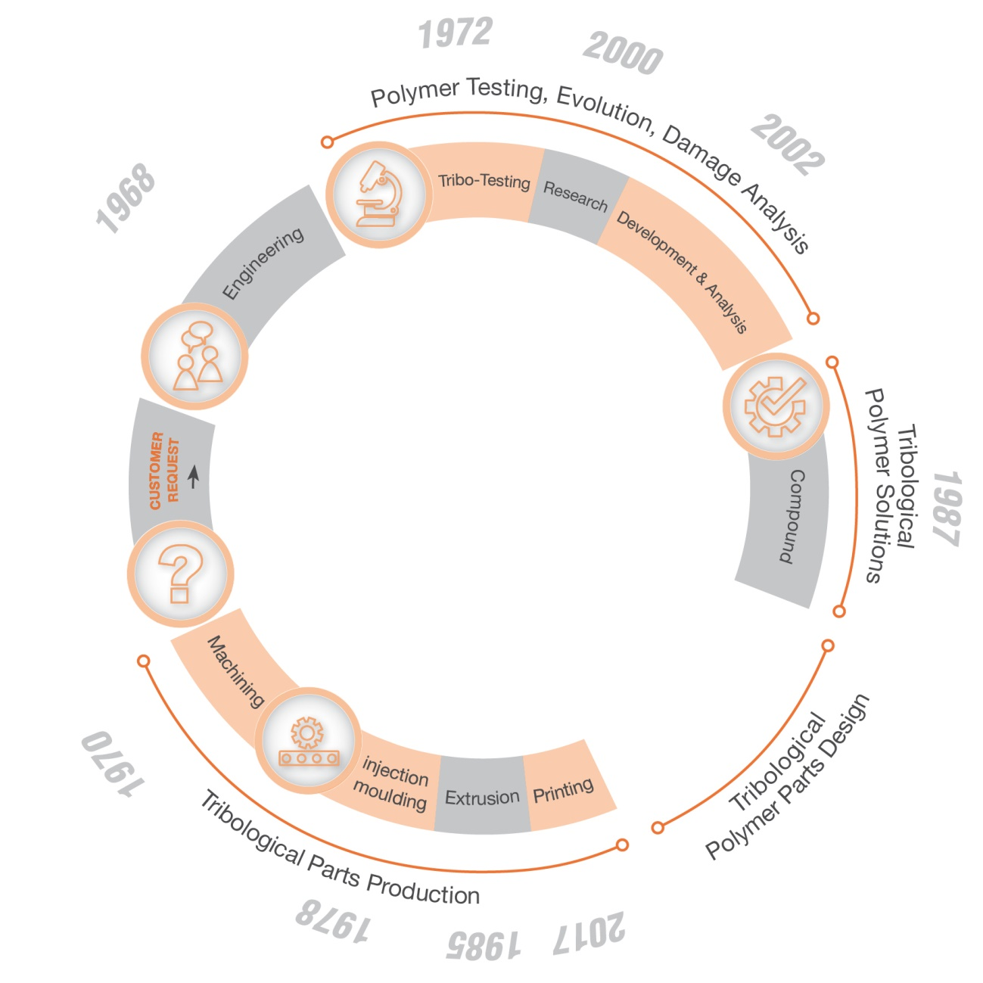
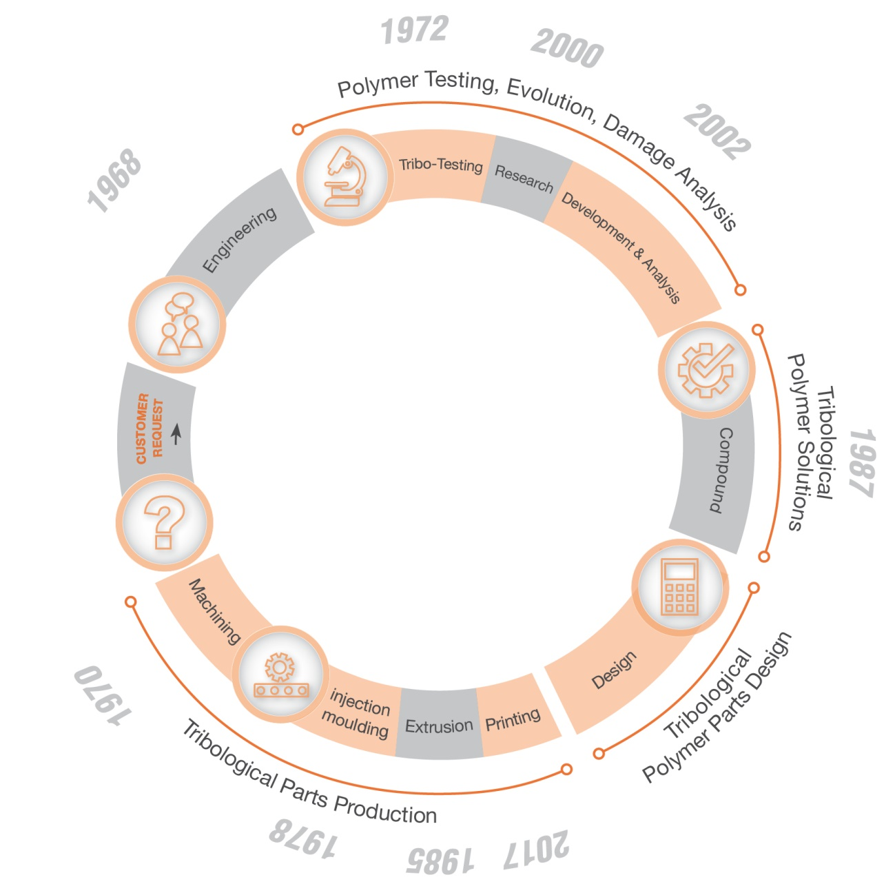
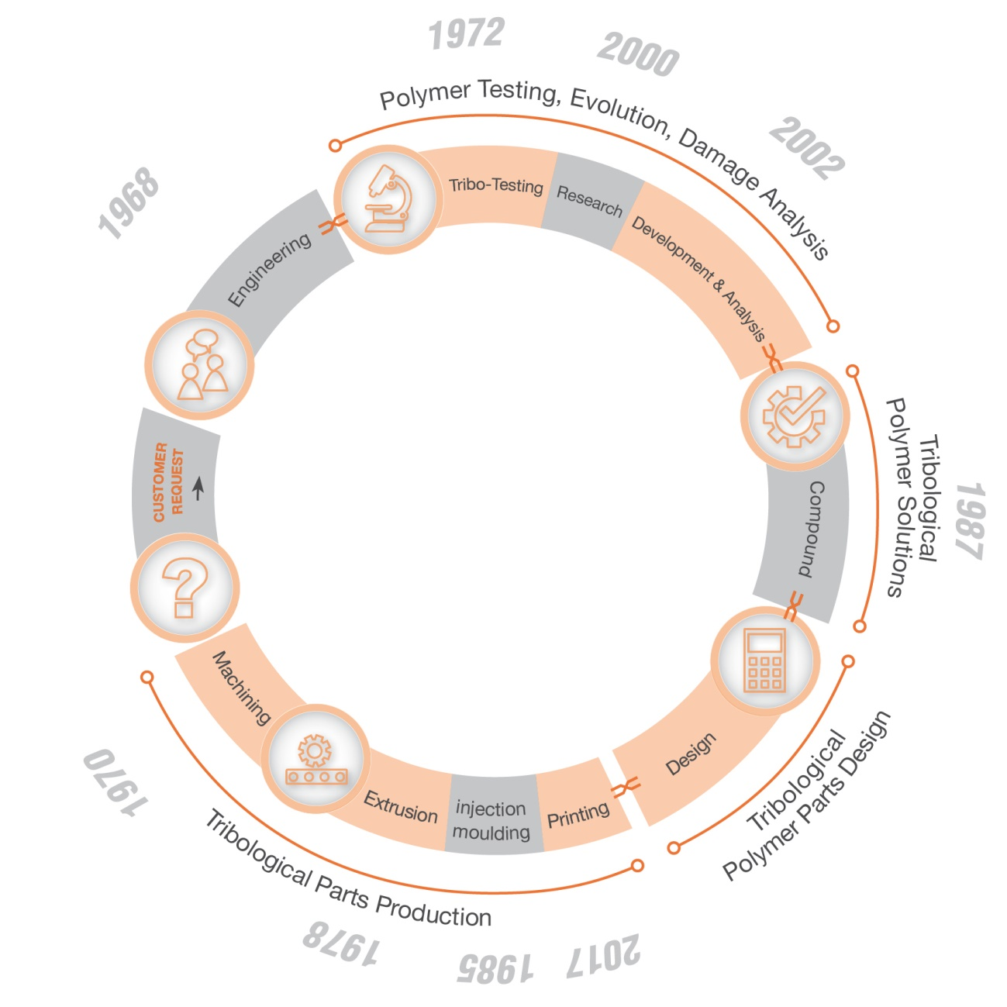
HISTORY
1968 Founded as a technical distributor of plastic parts
1987 Formulations had to be adapted to the friction and wear requirements
1970 Experienced machinists had problems with the "new" plastics
founded
1968
50+ years experience
2000 In order for service life predictions to become more accurate and reliable, Wolf compounds had to be studied in more detail
1972 The use of plastic as a wear component required wear values for material selection
2002 To enable customers to solve problems based only on a failure part, procedures have been developed for root cause identification
1978 The first "old" materials such as bronze were replaced by injection-molded plastic bushings in series production
1985 Economically optimal shapes of semi- finished products for machining (tubes) were rare
2017 Development of customized ZEDEX materials for FDM/FFF printing with near- semi-finished properties
50 years of tribology testing and plastic engineering
45 years Component production in injection molding and machined
37 years Extrusion
35 Years Compounding
20 years Plastics Lab at University Level

Slide 4
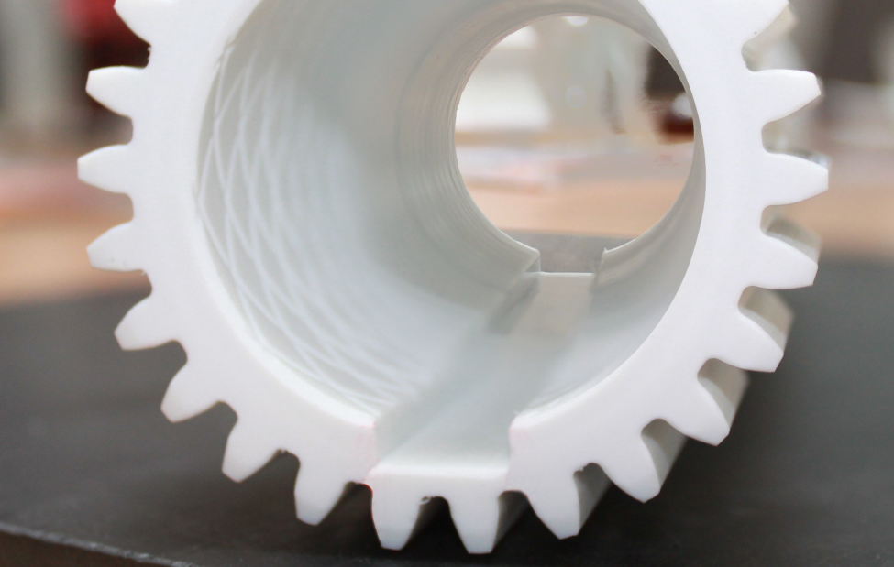
OUR EXPERIENCE IS YOUR PRODUCT
„From the idea to the finished product - everything from a single source.“
A product goes through several phases in its development.
From the idea to the finished product, we map all process steps of product development and can react flexibly and creatively at any time to realize a successful product.
PRODUCT

Slide 5
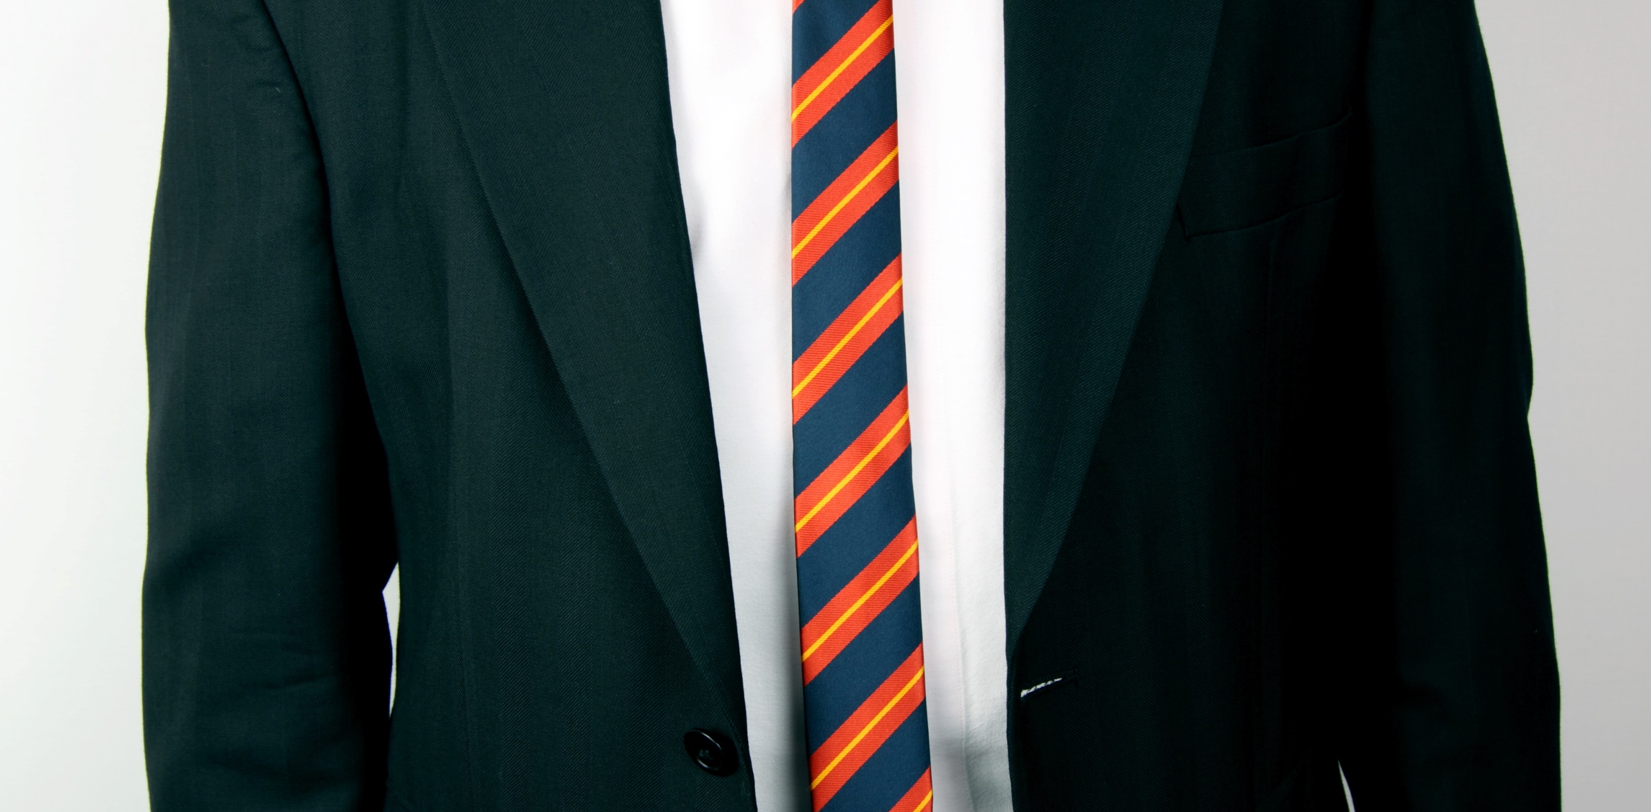
OUR EXPERIENCE IS YOUR PROFIT
„ Meeting requirements no more, but also no less.“
A machine element made of plastic should be designed in such a way that it meets the requirements but does not have any unnecessary safety features.
Only experience, knowledge and creativity can achieve this goal.

Slide 6
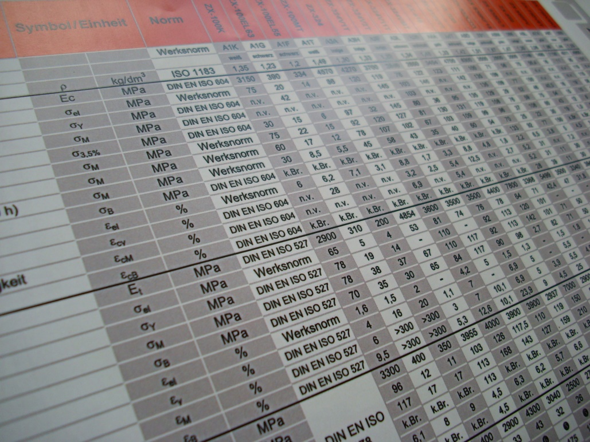
OUR EXPERIENCE IS YOUR SAFETY
„We offer 50 years of experience in the processing and dimensioning of high-performance plastics.“
Always one step ahead through experience. Our greatest source of knowledge is the characteristic values from over 50 years of materials and component testing.
You can benefit from our many years of success.

Slide 7
OUR DAILY BUSINESS
RESEARCH
Research
We constantly monitor new developments and trends on the market. We carry out basic research in order to understand plastics even better and to integrate the findings into our products so that our ZEDEX® high-performance plastics are always up to date
PRODUCT

Slide 8
OUR DAILY BUSINESS
DEVELOPMENT
Research
Development
PRODUCT
We are able to integrate your required properties into existing ZEDEX® high-performance plastics, through modification.

Slide 9
OUR DAILY BUSINESS
YOUR REQUIREMENTS
Research
Development
PRODUCT
If you have high demands on your plastic product and want to reduce component costs, we are the right partner.
Product requirements

Slide 10
OUR DAILY BUSINESS
CUSTOMER SERVICE
Research
Development
We support you in the selection of materials and dimensioning of your components and design them appropriately for the material, processing and load.
no question remains unanswered.
PRODUCT
Product requirements
Customer Service

Slide 11
OUR DAILY BUSINESS
CALCULATION & DESIGN
Research
Development
With the help of the latest technologies, we calculate the load capacity and service life for all sliding elements made of ZEDEX® polymers.
Accurately and without time-consuming attempts.
PRODUCT
Calculation Design
Product requirements
Customer Service

Slide 12
OUR DAILY BUSINESS
PROCESSING
Research
Product requirements
Customer Service
Calculation Design
Processing
Development
PRODUCT
We manufacture finished parts from ZEDEX® polymers for you cost-effectively in any quantity using the optimum process.

Slide 13
THE WAY TO THE SOLUTION IS ZEDEX
Your benefits:
Short and direct process chain
Reduced product development time
Direct communication paths
Decreased error influence
Controlled product impact
Products that meet requirements
Clear areas of responsibility
Cost reduction
Customer satisfaction

Slide 14
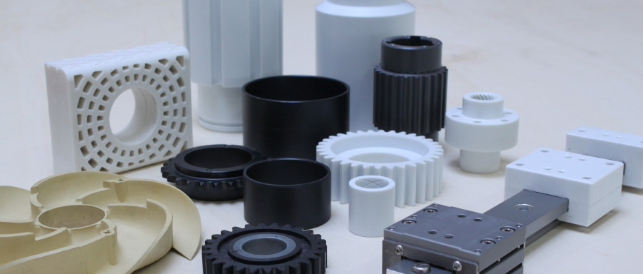
PLATZHALTER BILD
WHAT IS ZX® OR ZEDEX®
ZEDEX® and the abbreviation ZX® are trademarks of Wolf Kunststoff-Gleitlager GmbH and identify the high-end products of Wolf Kunststoff-Gleitlager GmbH.
The ZEDEX® material families are based on engineering & high-performance polymers and are were born from the experience gained in our over 50 years of activity in solving the problems deriving from the use of plastic materials as machine elements.

Slide 15
Classification of the ZEDEX® high-performance plastics
^{Made from} PET, PK, PPS, PEI, PEEK, TPI
Imidized Materials
PBI
310 °C
300 °C
250 °C
240 °C
180 °C
160 °C
140 °C
130 °C
120 °C
110 °C
100 °C
90 °C
80 °C
60 °C
Best physical properties above 260°C
Best temperatue resistance
High temperature, high load bearing and wear capabilities (bearing graded)
Good chemical resistance
PI
Amorphous High Performance Materials
PAI
PEEK
Semi-Crystaline High Performance Materials
LCP | PPS | PTFE | PF A | PFE | PCTFE
High service temperature
High strength
Hot water and steam resitance
Thermoformability
PPSU | PES
High service temperature
Excellent chemical resistance
High purity
PA | PSU
Amorphous Engineering Plastics
Semi-Crystaline Engineering Plastics
General purpose structural parts
Moderate strength
Moderate temperature
Good dimensional stability
Good izod impact
Easily fabricated
PA4.6 | PVDF | PPA
General purpose structural parts
Moderate strength
Moderate temperature
Good dimensional stability
Good izod impact
Easily fabricated
PS | ABS | SAN
Amorphous Commodity Plastics
PC
PA6.6 |PA6.10 | PA6 | PET | PBT
Semi-Crystaline Commodity Plastics
Low temperature
Low strength
Good bondability
Good machniabilit
Good formability
Low cost
PP
Low temperature
Low strength
Good chemical resistance
Low moisture absorption
Low cost
PMMA
PA12
PVC
PE
General Characteristics
General Characteristics
Softens over a wide temperature range
Easy to thermoform
Transparent
Poor chemical resistance
Bonds well using adhesives or solvents
Prone to stress cracking
Poor fatigue resistance
Structural applications only (not suitable for bearing and wear)
Sharp melting point
Opaque
Good chemical resistance
Resistant to stress cracking
Good fatigue resistance
Good for bearing and wear
(as well as structural applications)

Slide 16
Classification of the ZEDEX® high-performance plastics
^{Made from} PET, PK, PPS, PEI, PEEK, TPI
Imidized Materials
PBI
310 °C
300 °C
250 °C
240 °C
180 °C
160 °C
140 °C
130 °C
120 °C
110 °C
PI
ZX - 750
Amorphous High Performance Materials
PAI
Semi-Crystaline High Performance Materials
ZX - 324
PEEK
ZX – 530
LCP | PPS | PTFE | PF A | PFE | PCTFE
PPSU | PES
ZX – 410
PA | PSU
ZX - 610
Amorphous Engineering Plastics
Semi-Crystaline Engineering Plastics
ZX – 200
PS | ABS | SAN
PVDF newlife
PA4.6 | PVDF | PPA
ZX – 100 K

Slide 17
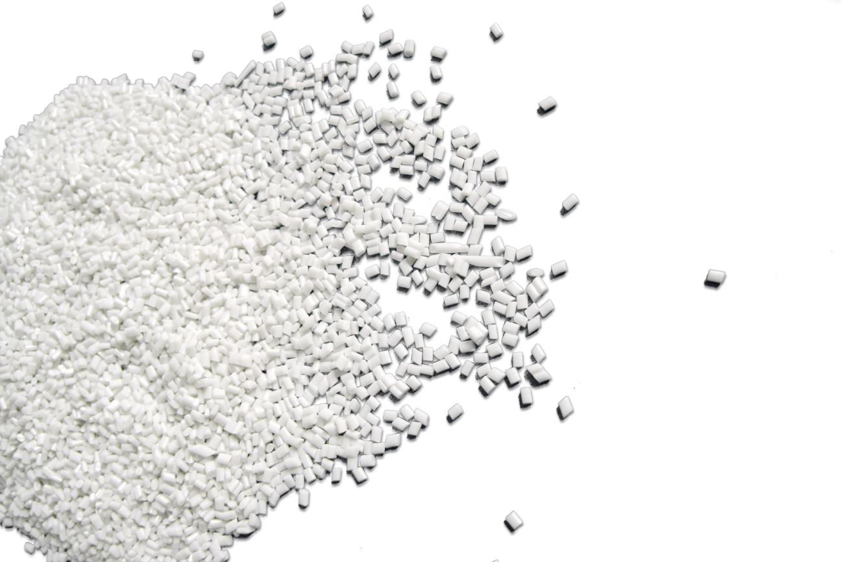
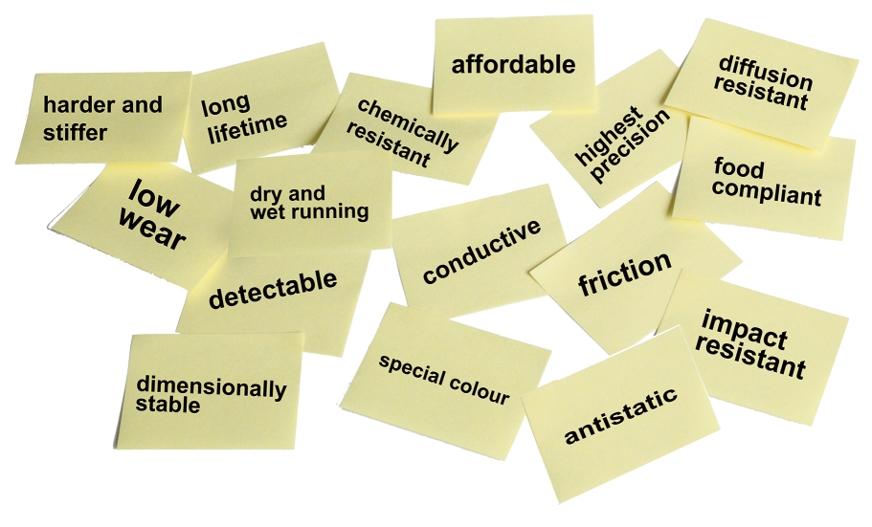
NEW
From the molecule to the application
chemically coupled PTFE / high performance plastics based on PPS, PAEK, PES, PEI, LCP available.
ZEDEX® MATERIALS CAN BE
Basic Type
Modifications
Special Compounds
As a basis for our compounds, we use base polymers which have a suitable property profile for sliding elements.
We have developed successful tribocompounds for the individual base polymers over the last 50 years.
Based on the basic types or modifications, we manufacture customer or application-specific compounds with functional integration.
ZX-324 (PEEK BASIS)
ZX-324V1T
(Tribo and cost-optimized)
ZX-324V1CFG
(Base ZX-324V1T – additionally thermal conductive)
In some cases, an optimization is not necessary, so we also process commercially available polymers. ^{Such as:}
The differences to the base polymer
^{are mostly in:}
^{Possible modifications:}
PET
PVDF
ETFE
PK
PPS
PEI
PEEK
TPI
LCP
PAI
Higher elasticity and rigidity
Reduction of friction and wear
Higher precision

Slide 18
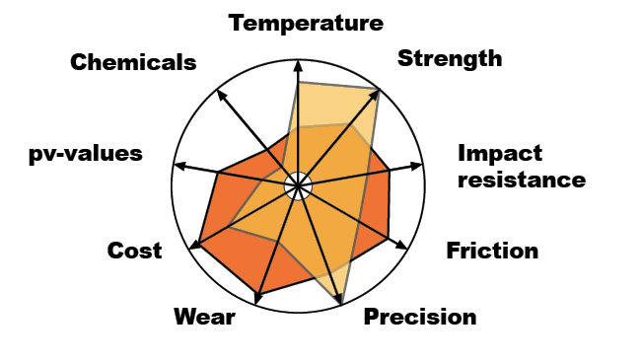
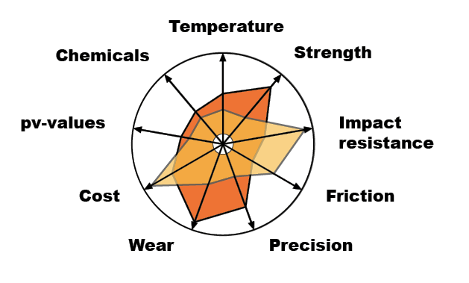
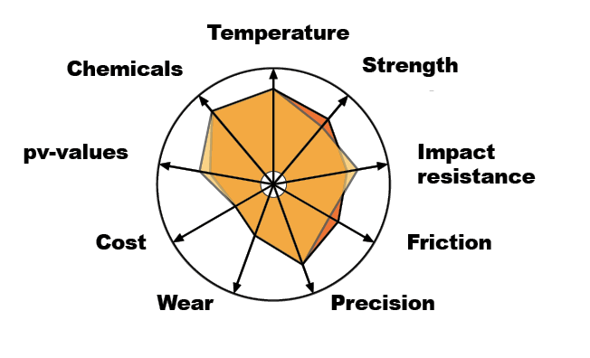
ZX-100
THE “LITTLE PEEK”
ZX-200
THE ELASTIC MOLDING WONDER
ZX-324 THE ALL-ROUNDER UP TO 250°C
ZX-100 is the all-round solution for a wide variety of applications in the food sector or for rough outdoor applications.
It is designed for dry running and saves weight and costs compared to bronze.
The ZX-200 family is based on PK and, like PEEK, belongs to the polyketone group. It has excellent elasticity, meaning it can be stretched greatly with very little permanent deformation and returns to its original state after relaxation.
Suitable for high temperatures combined with high surface pressure, because ^{ZX-324 is based on PEEK.}
The modified grades of the ZX-324 family have a higher wear resistance than PEEK.
ZX-100K vs. Bronze
ZX-200 vs. PA12
ZX-324V1T vs. PEEK

Slide 19
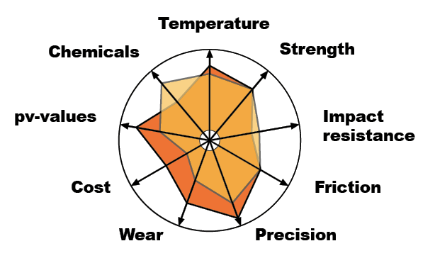
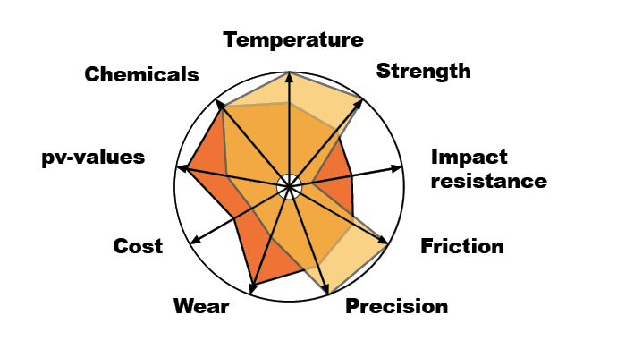
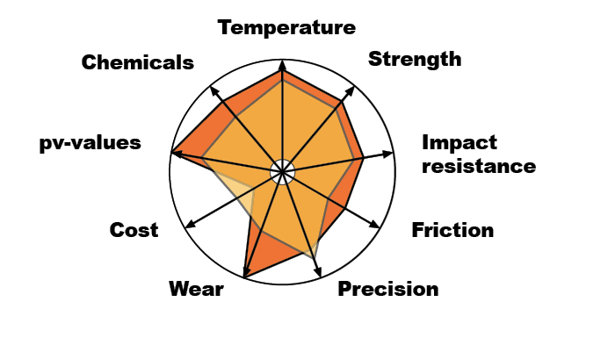
ZX-410
THE PRECISE UP TO 180 °C
ZX-530 THE SPECIALIST FOR CHEMICALS
ZX-750 ALL-ROUNDER IN AREAS WITH HIGH TEMPERATURES
For the medium sliding speed range, large surface pressure and high precision - also ideally suited for high temperatures.
Ideally suited for applications with ^{aggressive chemicals.}
ZX-530 combines the advantages of PTFE and ceramics, convinces with low friction values and high wear resistance.
^{ZX-530 is stiffer than PTFE.}
^{ZX-750 has the highest maximum} pv values of the ZEDEX® materials.
^{Even temperatures up to 300 °C} ^{leave it cold.}
ZX-410VMT vs PEEK mod.
ZX-530 vs. Ceramics
ZX-750V5KF vs. PAI

Slide 20
Our contribution to sustainability
The new life family contributes significantly to the reduction of waste, the use of resources and primary energy. In comparison to thermal recycling, a considerable amount of CO2 emissions is avoided.
The products of the ZEDEX® new life family are subject to the rigorous checks of process values & technical characteristics, which are also applied when processing virgin goods. The high quality standards should encourage our customers to opt for products with a new life cycle.

Slide 21
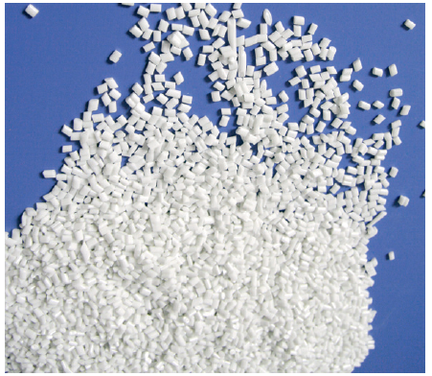
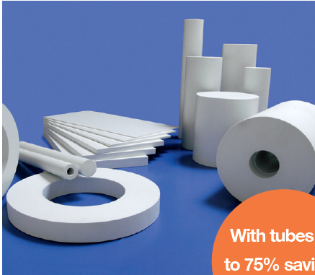
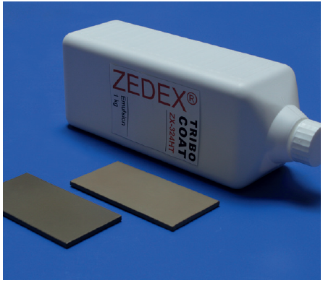
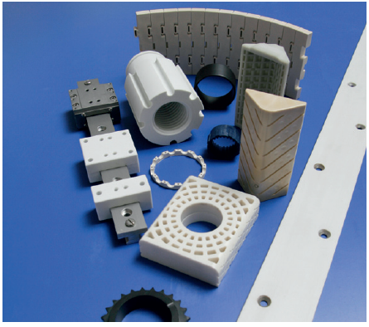
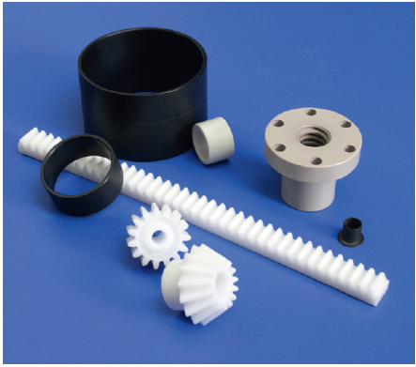
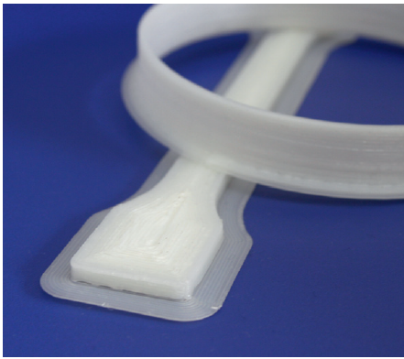
DELIVERY FORMS OF OUR PRODUCTS
PLASTIC GRANULES
SEMI FINISHED PRODUCTS
COATING, COATED PARTS
with tubes up to 75% savings possible
CUSTOMER SPECIFIC PARTS
INTERCHANGEABLE PARTS
3D PRINTING

Slide 22
OUR PRODUCTS
Semi-finished Products
Sheets, Rods, Tubes
Granules
Standard and Special Compound
3D Printing
Standard and Custom parts
3D Printing
Filaments
Tribo-Coating
Coating and coated parts
Laboratory tests
Research, Development and Analysis
Pump & Marine
Bearings
Consulting
We deliver solutions
Finished Parts
Standard and Custom parts

Slide 23
IF U WANT TO KNOW MORE
Tribological Polymer Solutions
Semi-finished products, granules
Special compounds
Tribological Part Production
Machining
Injection molding
3D printing
Polymer Parts Design
Consulting, calculation
Design
Tribological Polymer Parts
Precision plainbearings, slideway bearings
Movement nuts, gears
Onlineservice
Calculation-tools
Online Warehouse
Online Shop
Polymer Testing, Evolution, Damage analysis
Polymer testing, failure analysis
Compound development

