Slide 1

ONLINE SERVICES
LEARN MORE ABOUT OUR
ONLINE SERVICES FOR YOU

Slide 2
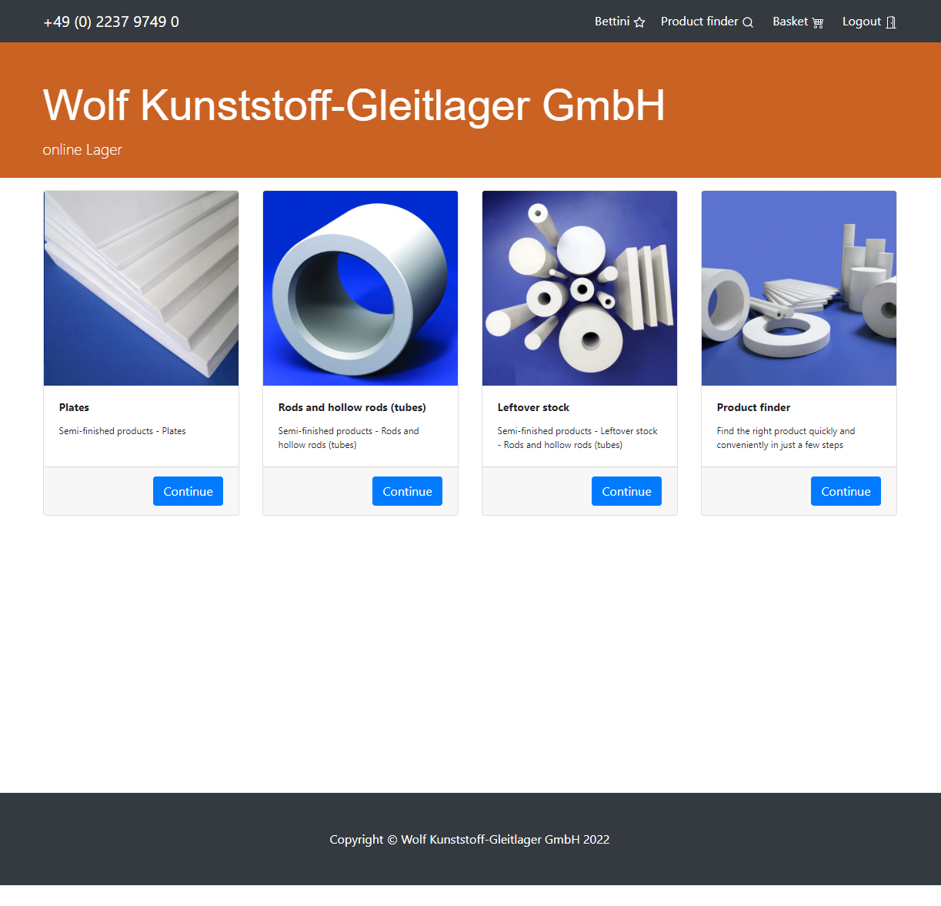

WAREHOUSE
NAVIGATION PAGE
After you have logged in with your account, you will get an overview
Plates
Rods and hollow rods (tubes)
Leftover stock
Product finder (comming soon)
You find it here: https://lager.zedex.de
ONLINE SERVICES

Slide 3
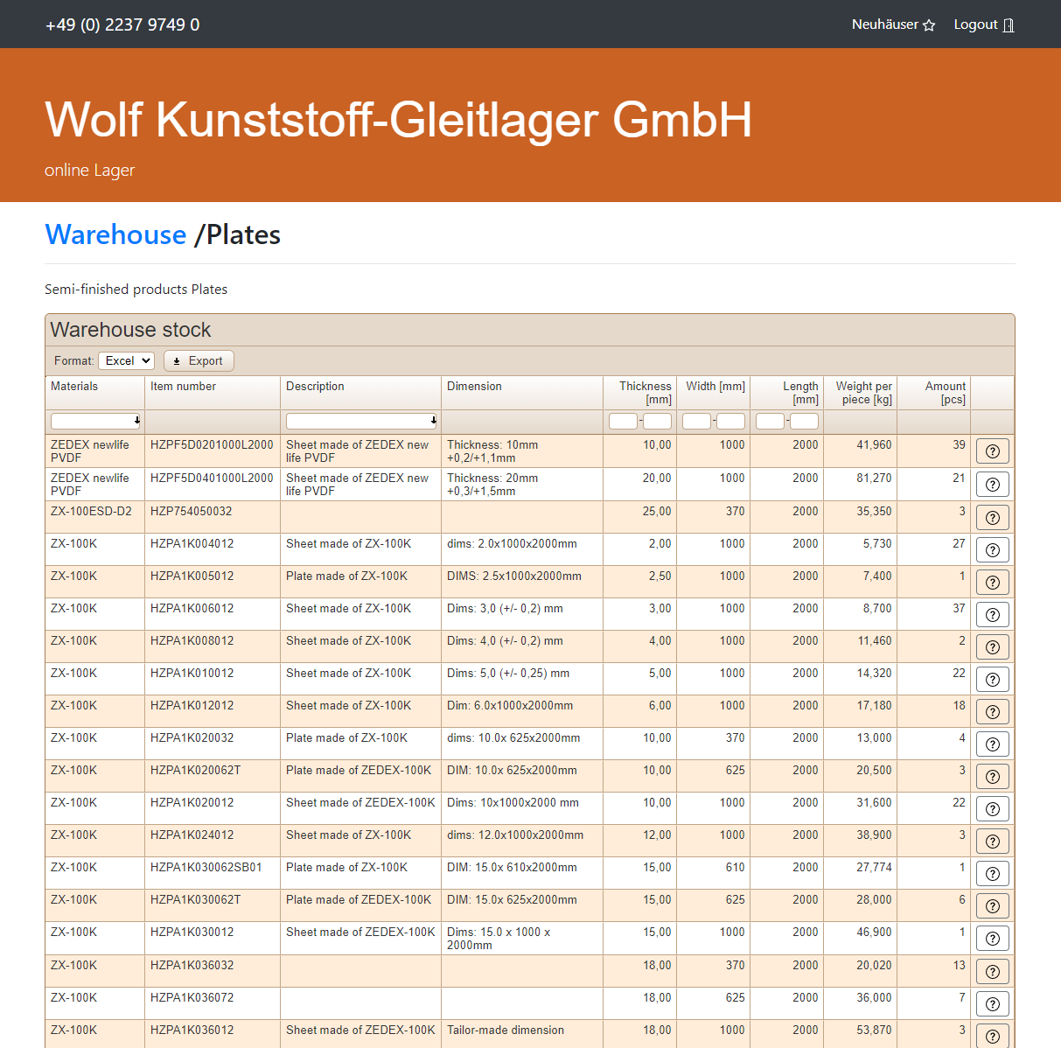
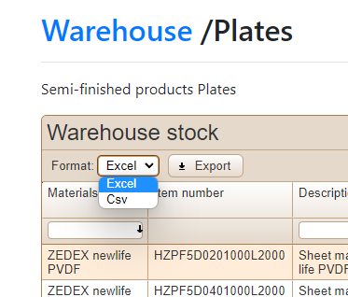
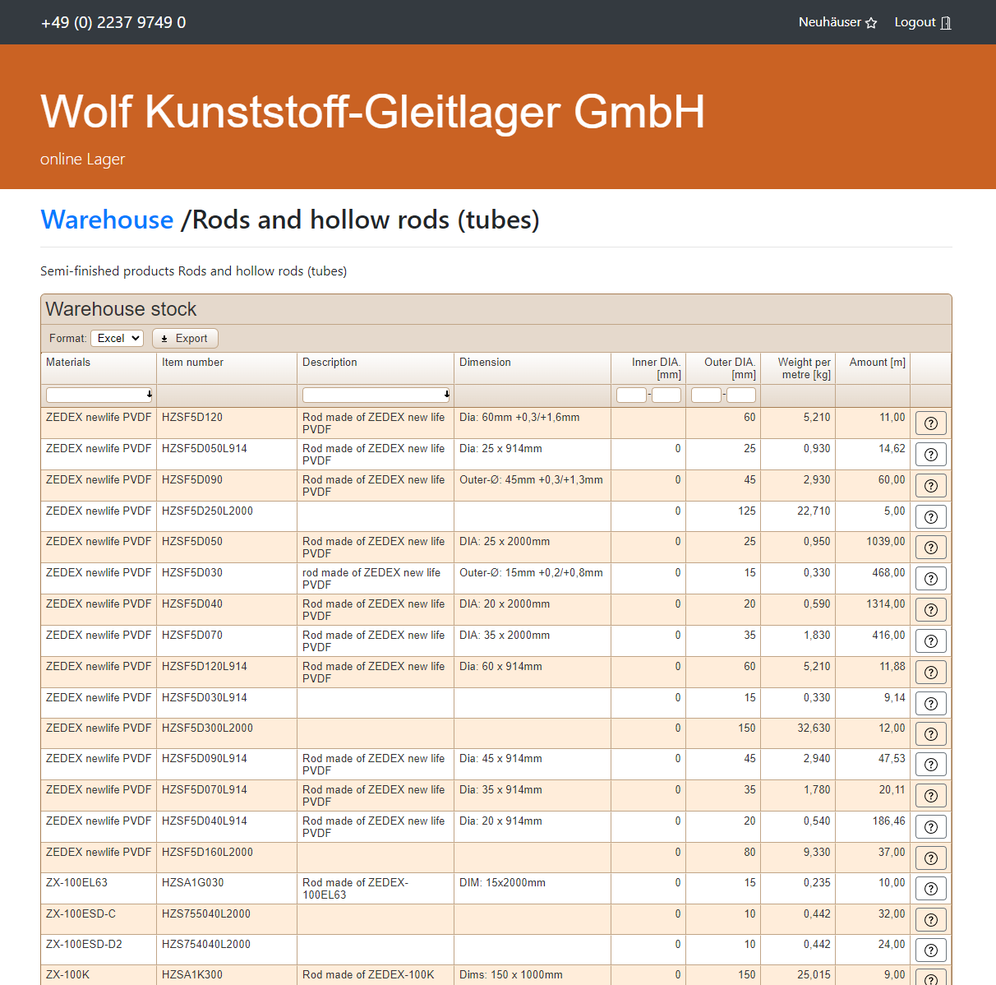
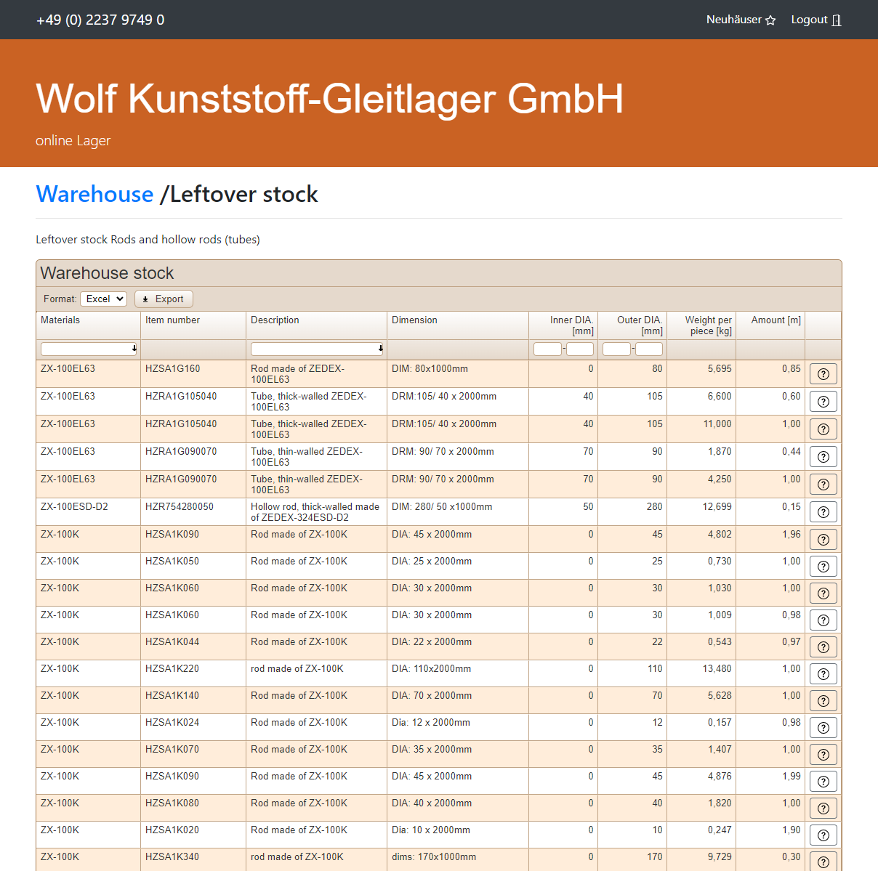
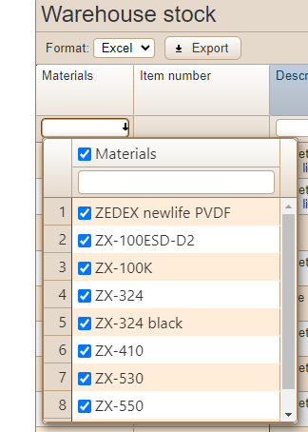
OVERVIEW
EXPORT
The current selection can be exported with one click (.xlsx or .csv)
FILTER
You have the possibility to filter the displayed products by material
ONLINE SERVICES

Slide 4
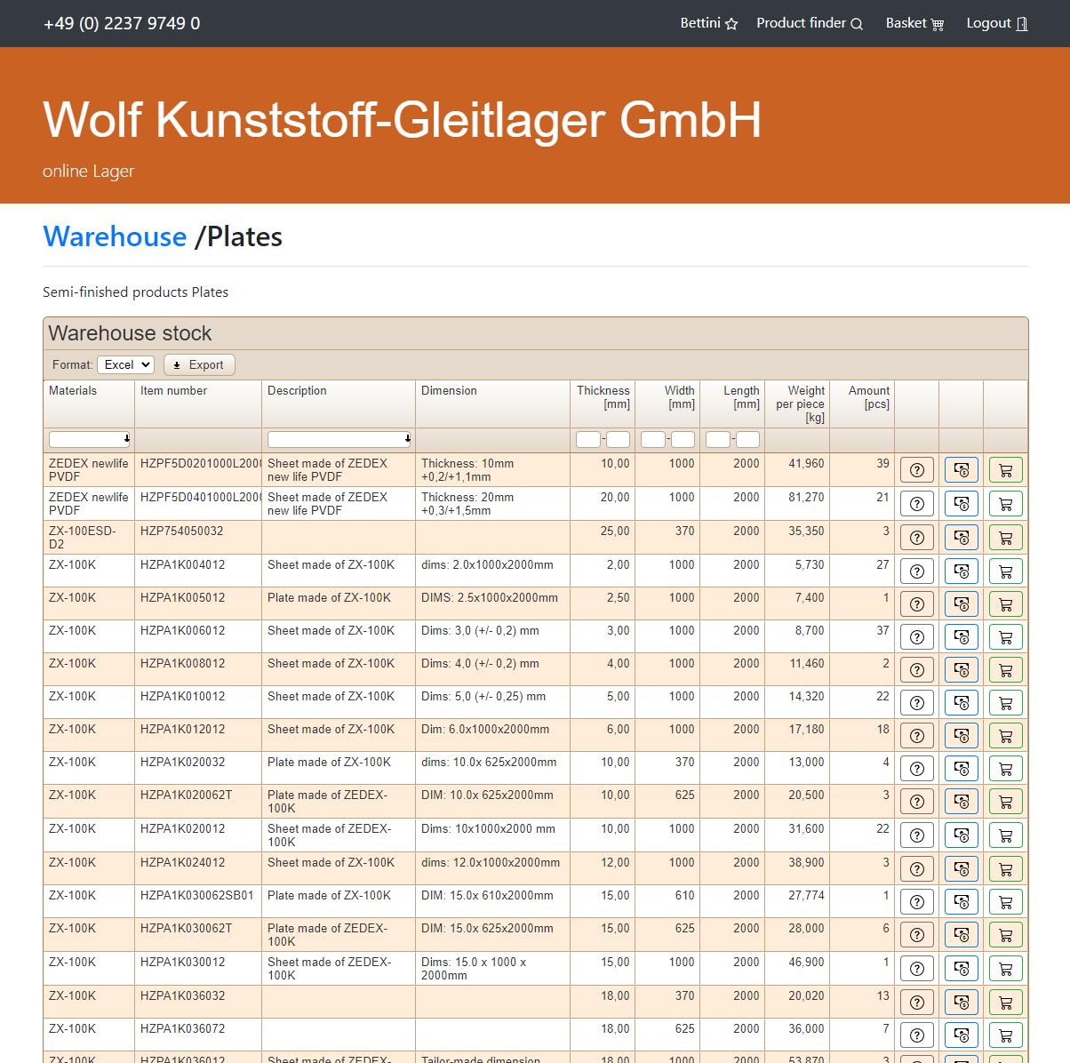
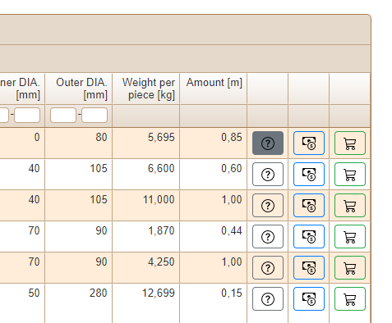
UPCOMMING FEATURES V2
ASK US
Ask a product specific question directly
CALCULATE
Directly submit a product specific price request
SHOPPING CART
Add the product to your shopping cart
ONLINE SERVICES
All requests will be answered by your personal agent

Slide 5
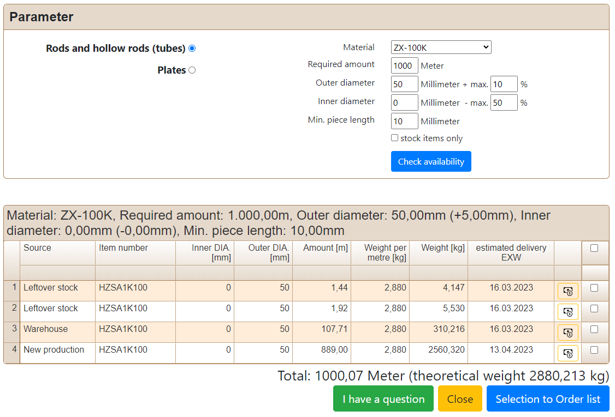
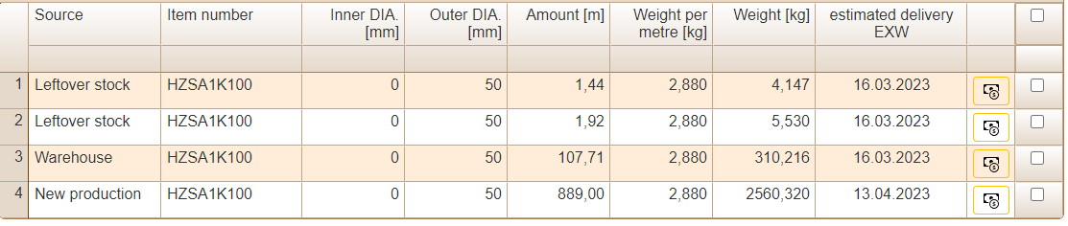
UPCOMMING FEATURES V2
FIND THE PRODUCT
YOU NEED
With the product finder you can directly find rods, hollow-rods and plates according to your needs.
SUITABLE POSITIONS
If your required quantity is not in stock,
our system will suggest you suitable positions as well as the new production of the possibly missing quantity. Subsequently, you can directly generate an order of your selection.
ONLINE SERVICES

Slide 6
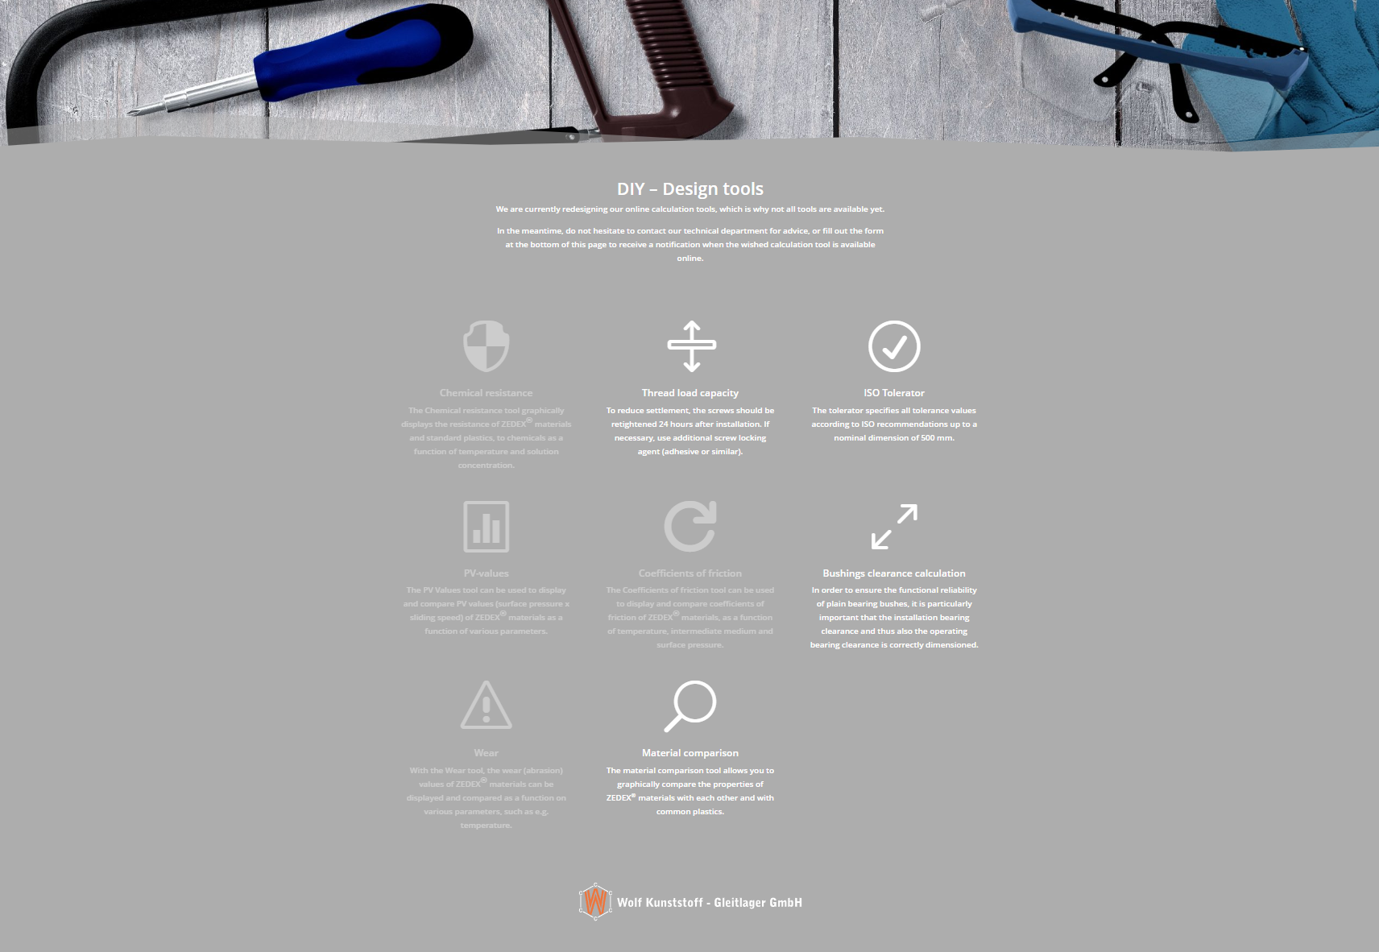
DESIGN TOOLS
DESIGN TOOLS
On our website you will find various calculation applications to verify and realize your project.
The selection of apps is currently being expanded.
You‘ll find them here: https://www.zedex.de/en/knowledge-centre/tools
ONLINE SERVICES

Slide 7
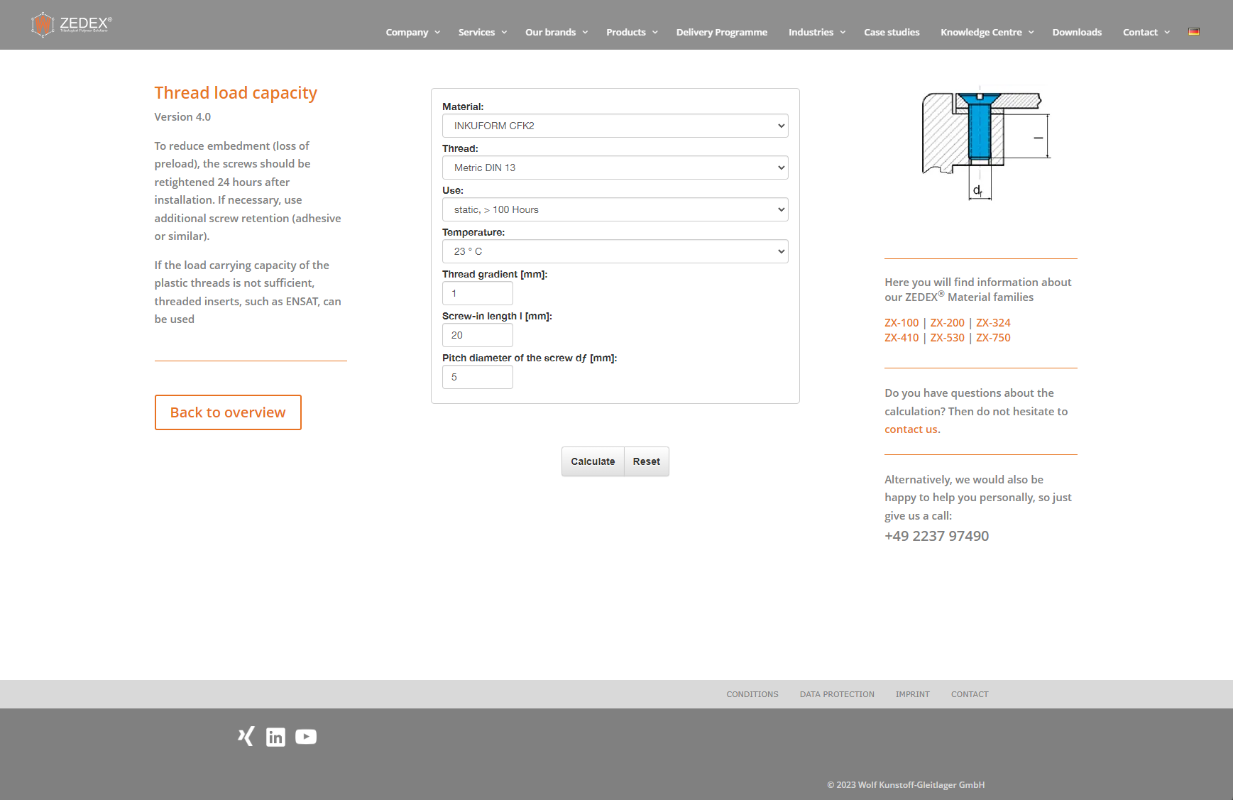
THREAD LOAD CAPACITY
ABOUT
To reduce embedment (loss of preload), the screws should be retightened 24 hours after installation. If necessary, use additional screw retention (adhesive or similar).
If the load carrying capacity of the plastic threads is not sufficient, threaded inserts, such as ENSAT, can be used
ONLINE SERVICES

Slide 8
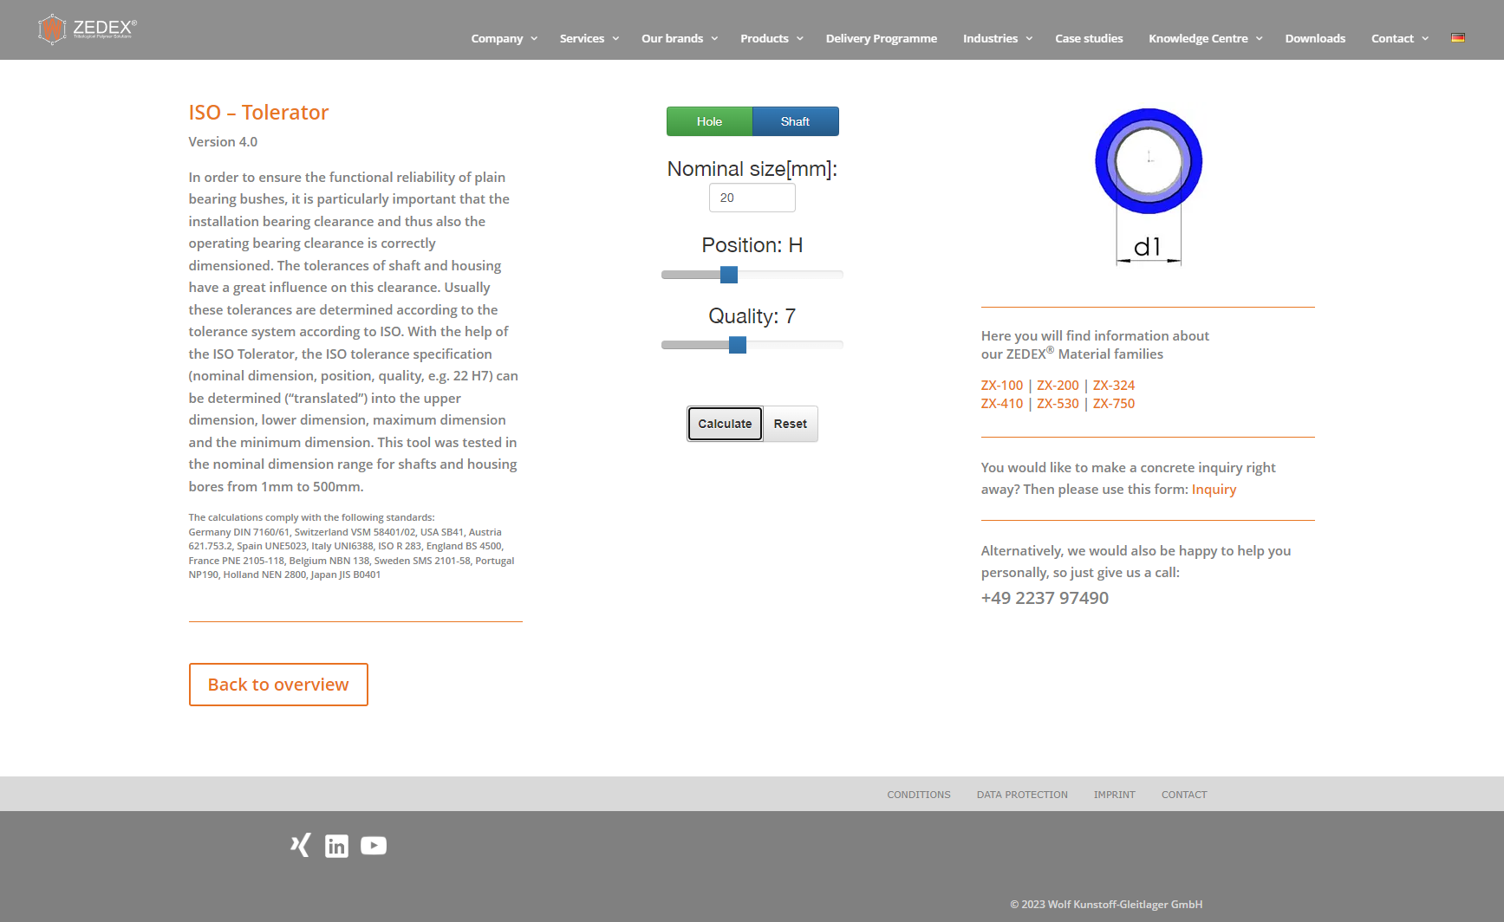
ISO - TOLERATOR
ABOUT
In order to ensure the functional reliability of plain bearing bushes, it is particularly important that the installation bearing clearance and thus also the operating bearing clearance is correctly dimensioned.
The tolerances of shaft and housing have a great influence on this clearance. Usually these tolerances are determined according to the tolerance system according to ISO. With the help of the ISO Tolerator, the ISO tolerance specification (nominal dimension, position, quality, e.g. 22 H7) can be determined (“translated”) into the upper dimension, lower dimension, maximum dimension and the minimum dimension.
This tool was tested in the nominal dimension range for shafts
and housing bores from 1mm to 500mm.
The calculations comply with the following standards:
Germany DIN 7160/61, Switzerland VSM 58401/02, USA SB41, Austria 621.753.2, Spain UNE5023, Italy UNI6388, ISO R 283, England BS 4500, France PNE 2105-118, Belgium NBN 138, Sweden SMS 2101-58, Portugal NP190, Holland NEN 2800, Japan JIS B0401
ONLINE SERVICES

Slide 9
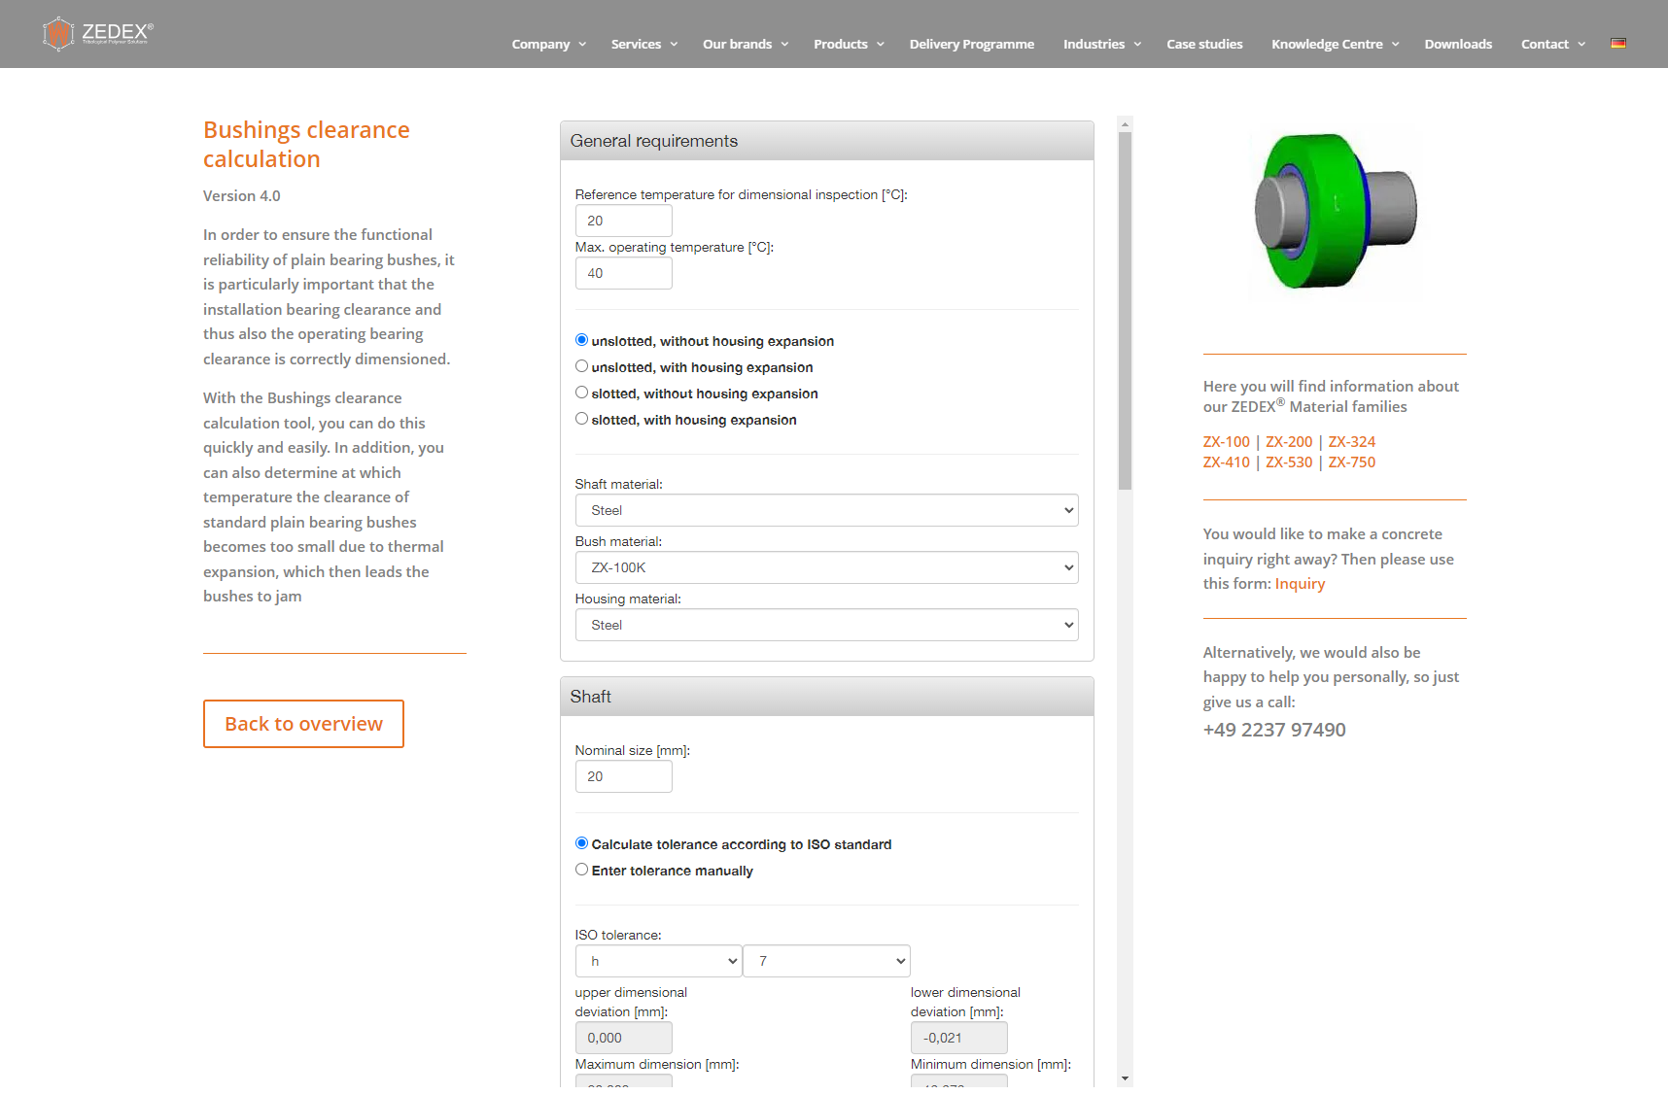
BUSHINGS CLEARANCE CALCULATION
ABOUT
In order to ensure the functional reliability of plain bearing bushes, it is particularly important that the installation bearing clearance and thus also the operating bearing clearance is correctly dimensioned.
With the Bushings clearance calculation tool, you can do this quickly and easily. In addition, you can also determine at which temperature the clearance of standard plain bearing bushes becomes too small due to thermal expansion, which then leads the bushes to jam
ONLINE SERVICES

Slide 10
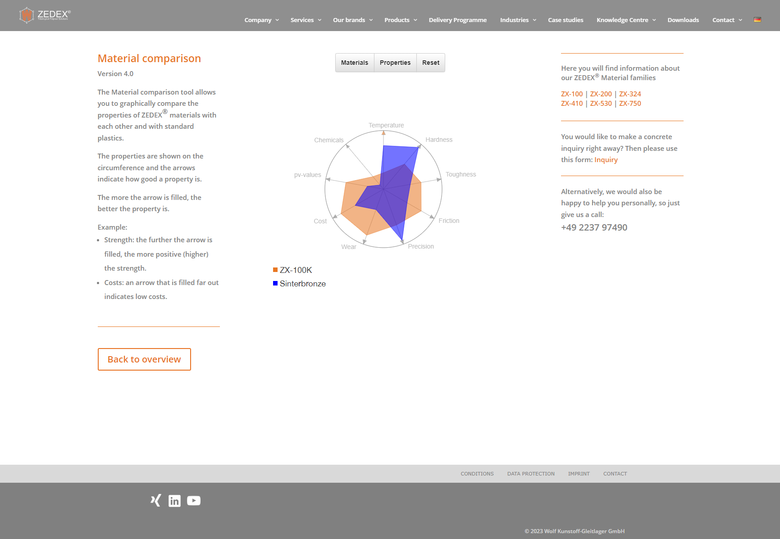
MATERIAL COMPARISON
ABOUT
The Material comparison tool allows you to graphically compare the properties of ZEDEX® materials with each other and with standard plastics.
The properties are shown on the circumference and the arrows indicate how good a property is. The more the arrow is filled, the better the property is.
Example:
Strength: the further the arrow is filled, the more positive (higher) the strength.
Costs: an arrow that is filled far out indicates low costs.
ONLINE SERVICES

Slide 11
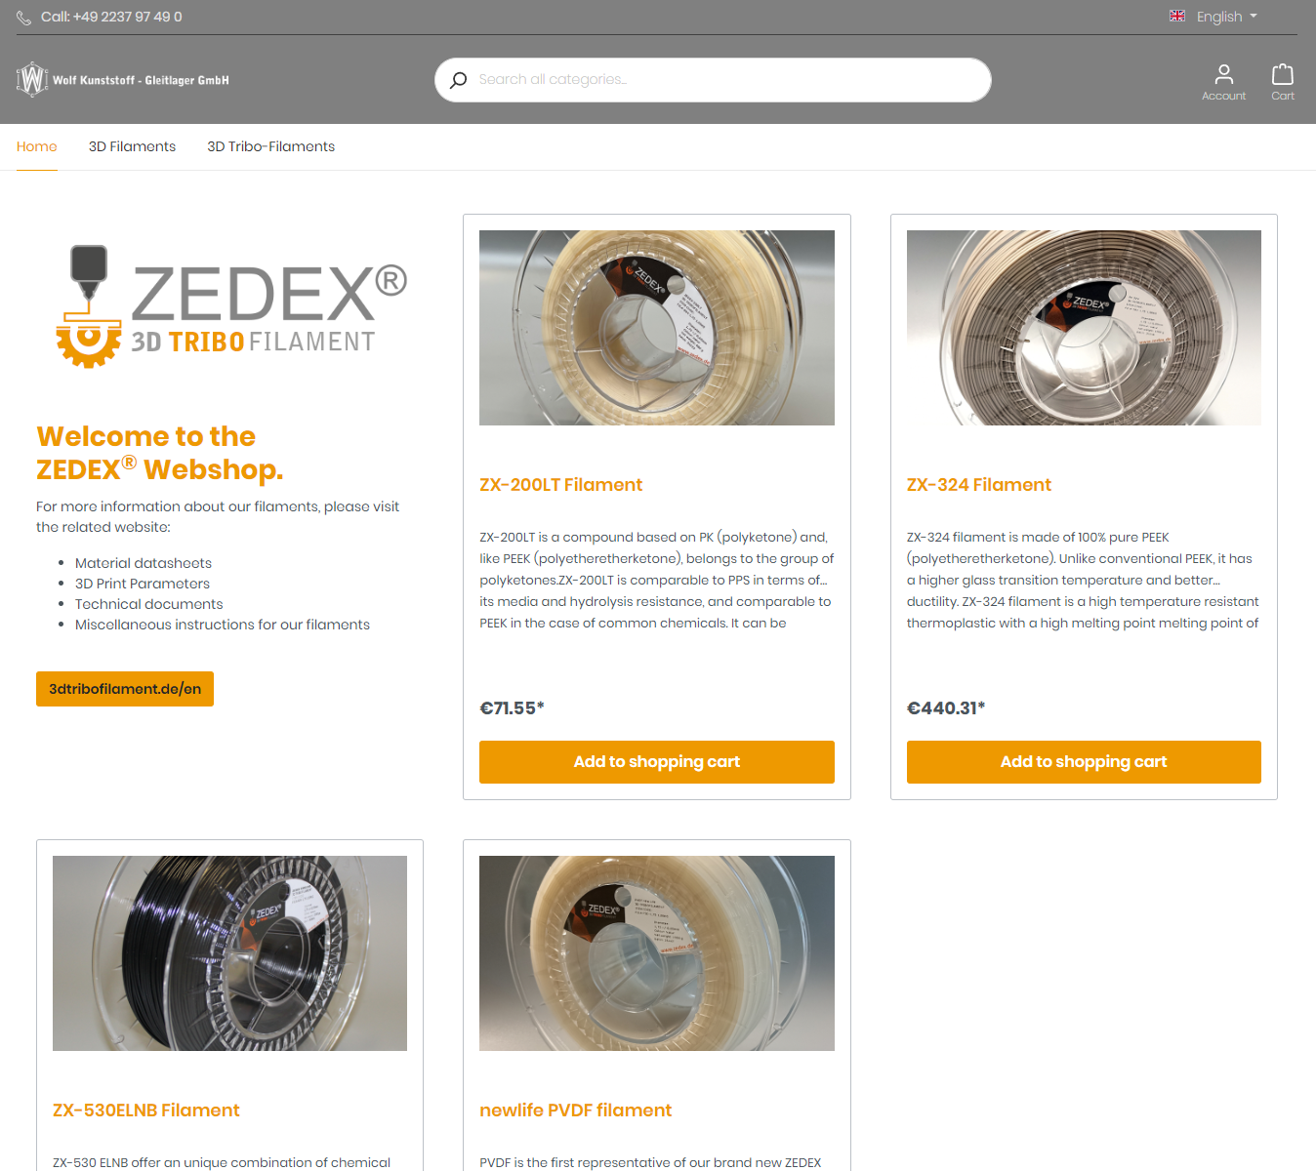
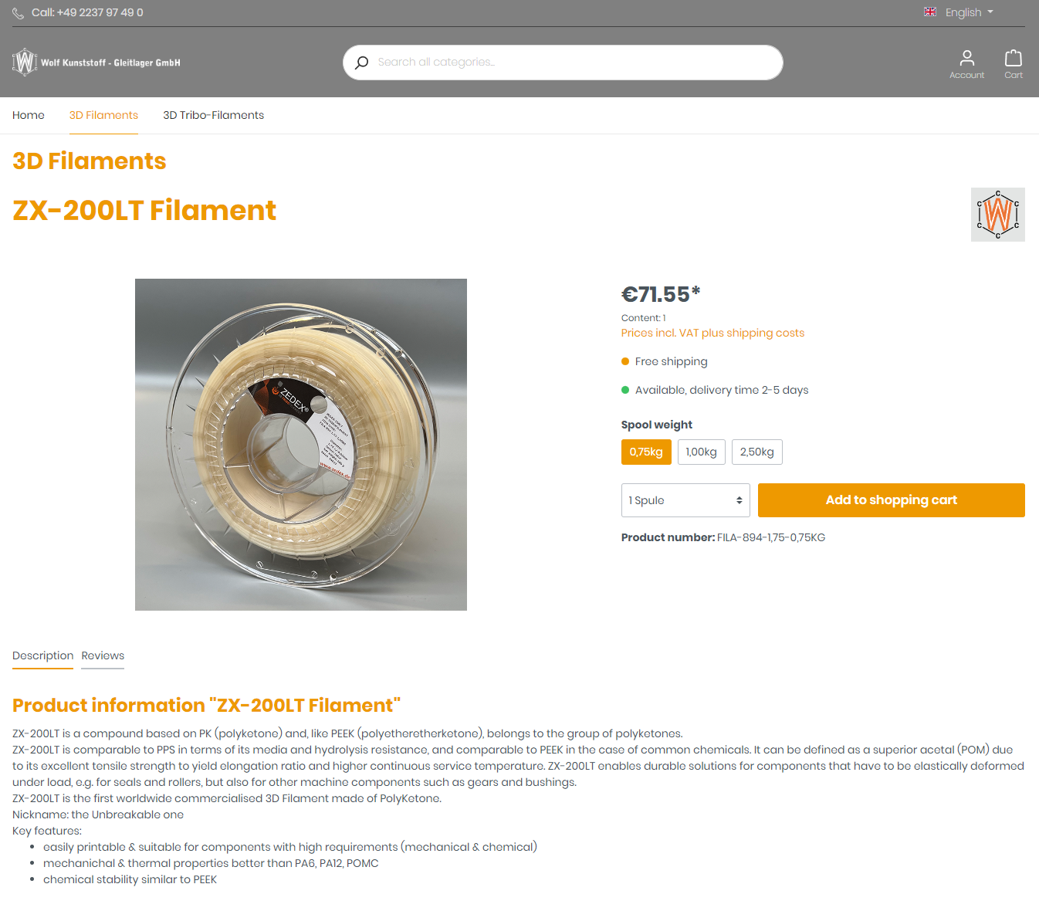
FILAMENT SHOP
3D-TRIBOFILAMENTS AND
3D-FILAMENTS
The store offers our products of tribofilaments and filaments for 3D printing for direct purchase.
You can find the webshop at: https://shop.zedex.de
ONLINE SERVICES

Slide 12
IF U WANT TO KNOW MORE
Tribological Polymer Solutions
Semi-finished products, granules
Special compounds
Tribological Part Production
Machining
Injection molding
3D printing
Polymer Parts Design
Consulting, calculation
Design
Tribological Polymer Parts
Precision plainbearings, slideway bearings
Movement nuts, gears
Online Services
Calculation-tools
Online Warehouse
Online Shop
Polymer Testing, Evolution, Damage analysis
Polymer testing, failure analysis
Compound development

