Slide 1
DELIVERY FORMS
LEARN MORE ABOUT
OUR DELIVERY FORMS

Slide 2
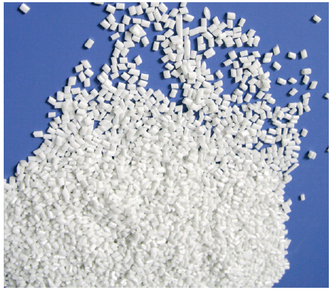
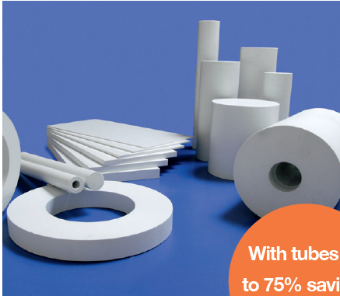
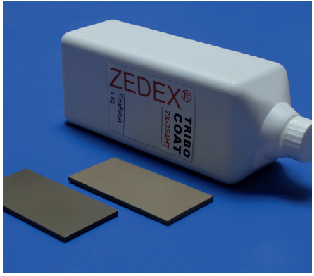
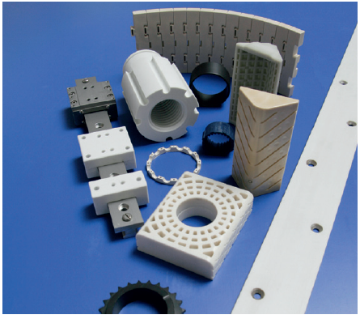
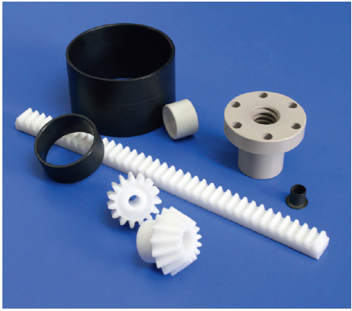
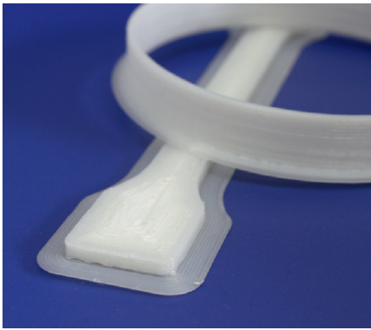
DELIVERY FORMS OF OUR PRODUCTS
PLASTIC GRANULES
SEMI-FINISHED PRODUCTS
COATING, COATED PARTS
with tubes up to 75% savings possible
CUSTOMER
SPECIFIC PARTS
STANDARDPARTS
3D PRINTING

Slide 3
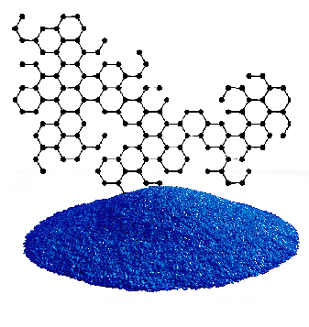
SPECIALCOMPOUNDS
GRANULES
We develop the plastic with your required properties for you - specifically for your application.
If the required material properties are not known,
we derive them from the application conditions of the planned component for you and create the formulation.
SPECIAL COMPOUNDS

Slide 4
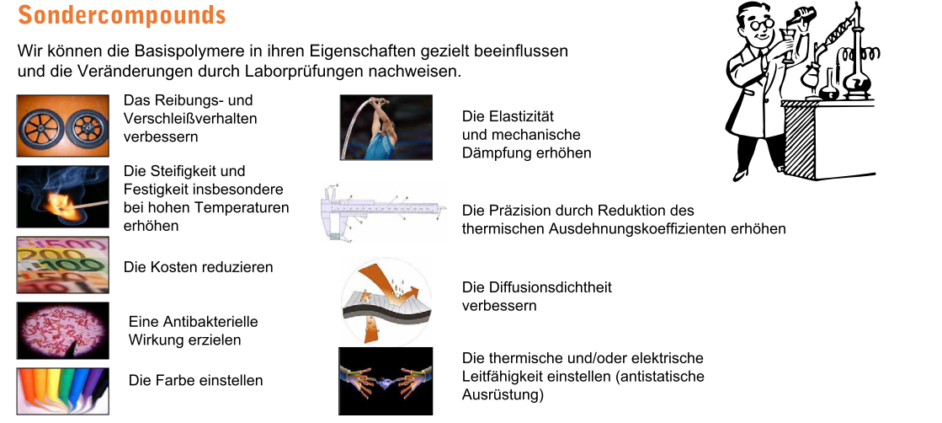
SPECIALCOMPOUNDS
WE CAN MODIFY THE PROPERTIES OF THE BASE POLYMERS IN A TARGETED MANNER
AND DETECT THE CHANGES THROUGH LABORATORY TESTS.
Improve the friction and
wear behavior
Increase the elasticity and mechanical damping
Increase the stiffness and strength especially at - high temperatures
Increase precision by reducing the coefficient of thermal expansion
Reduce the cost
Improve diffusion tightness
Achieve an antibacterial effect
Adjust thermal and / or electrical conductivity (antistatic equipment)
Adjust the color

Slide 5
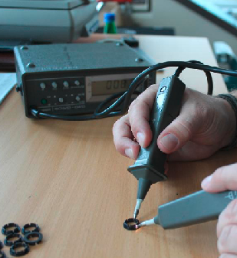
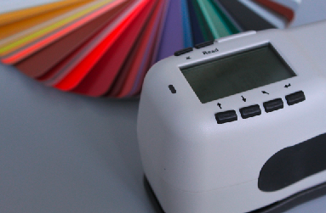
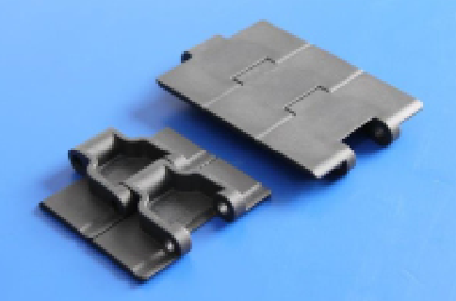
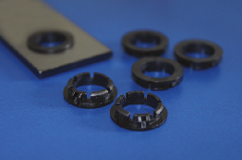
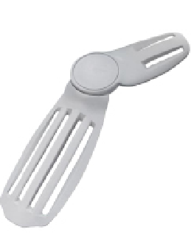
SPECIALCOMPOUNDS
ELECTRIC CONDUCTIVITY
COLOURFULNESS
FRICTION
Surface resistance from 70-160 kOhms at a measuring voltage of 100 V.
The color was set accordingly to a customer specification in one RAL colour tone.
The basic type was modified so that the friction coefficient against PET-bottles was minimized.
Example: ZX-530 >> ZX-530LR6
Example: ZX-324V2T >> ZX-324FDW2
Example: ZX-324 >> ZX-324AB

Slide 6
ADVANTAGES
BLUE DYED
^{Good detectable}
^{Cost and weight reduction}
Food conformity (EU 10/2011 approval in preparation)
under the following conditions:
Food types
All food types except foods containing 15%
or more alcohol
Application
Repeated use only for articles
Very good tribological properties
^{Can be sterilized}
Inkuform MDTF is a POM-C with very good tribological properties. For better optical recognition it is dyed in blue RAL 5010. Fragments can be identified with the usual metal detection devices. Depending on the device, fragments, e.g. cube with an edge length up to 2 mm, are detected. The friction and wear values are very good and better than standard standard types up to 80°C. An EU 10/2011 authorization is possible.

Slide 7
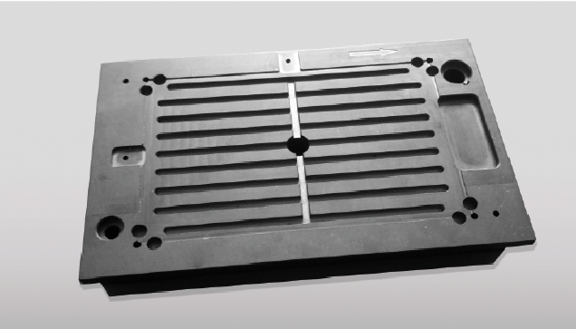
ADVANTAGES
PROPERTIES ZX-324ESD
electrostatically dissipative
high temperature resistance
high strength and dimensional
stability
high chemical resistance
settings of the surface electric
resistance to electric conductivity
are possible

Slide 8
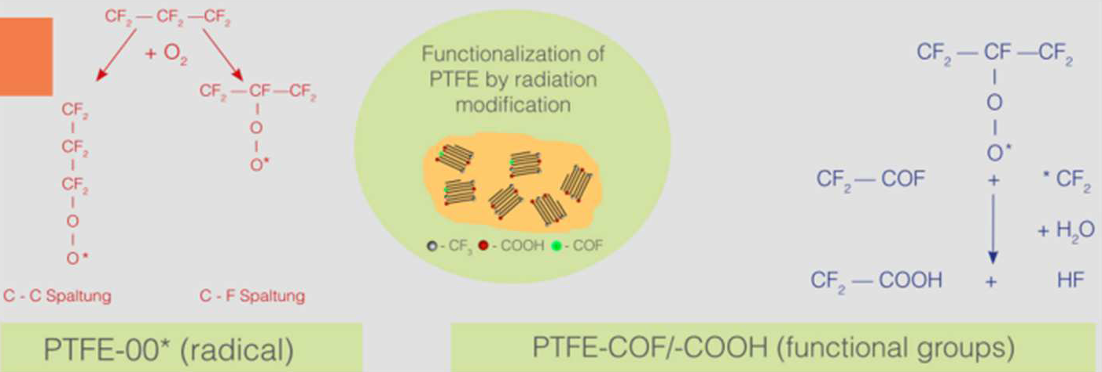
Production of high-performance plastics chemical bonded With PTFE
to achieve exceptional mechanical and tribological properties
GOAL
CURRENT STATUS
LAUNCH: Q3 / 2023
expensive irradiation of the ptfe
is required for the chemical bond.
this is to be replaced by commercially available inexpensive products
matching types found. tests still have
to be carried out
PROCEDURE

Slide 9
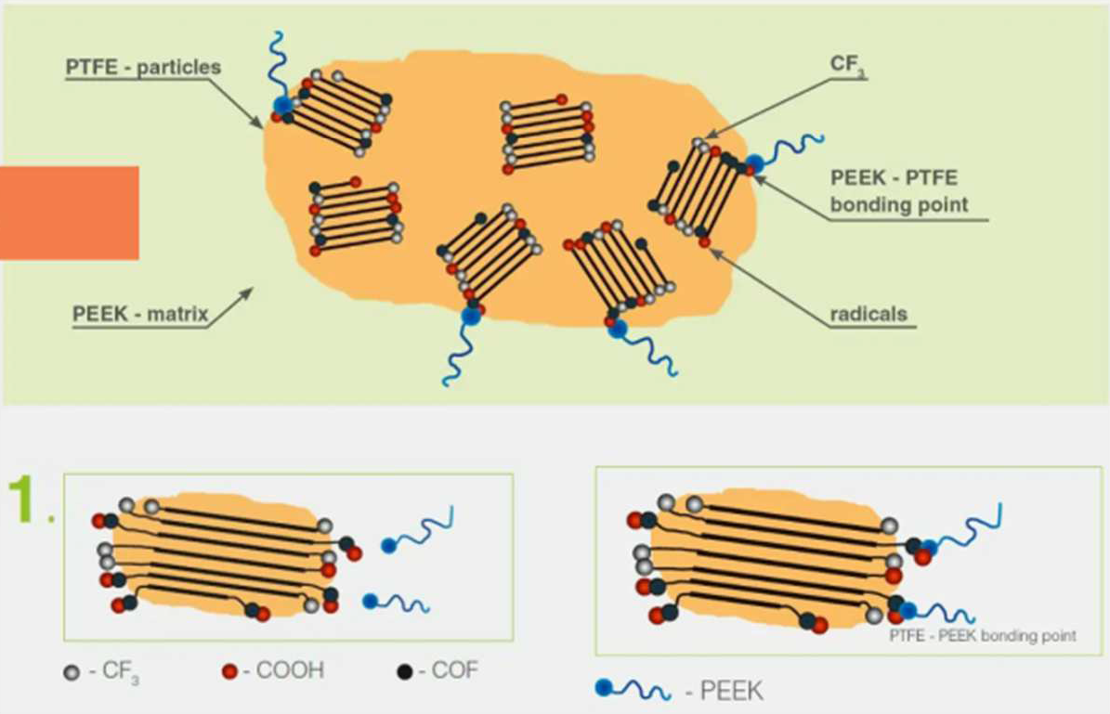
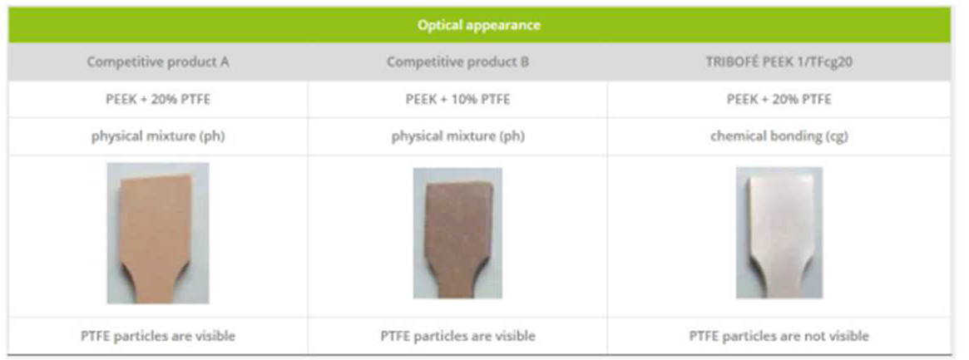
PROCEDURE

Slide 10
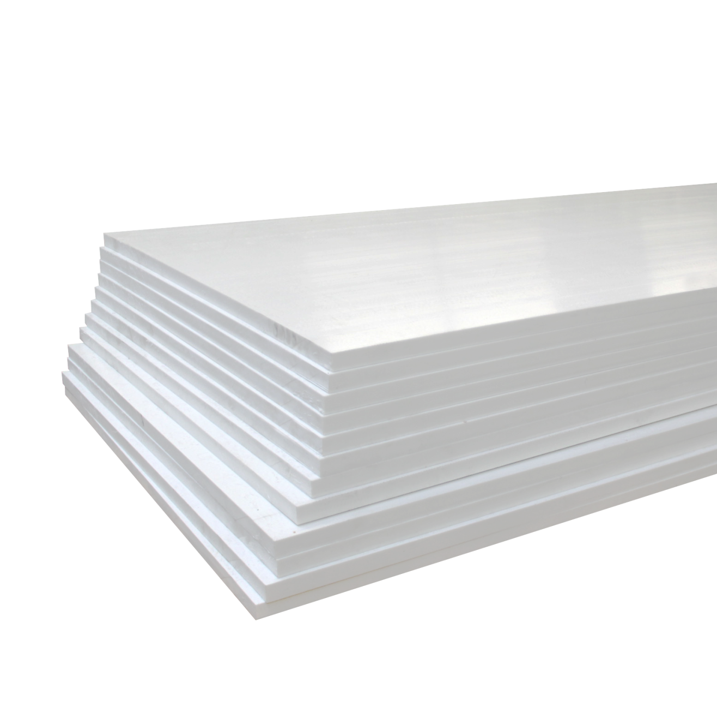
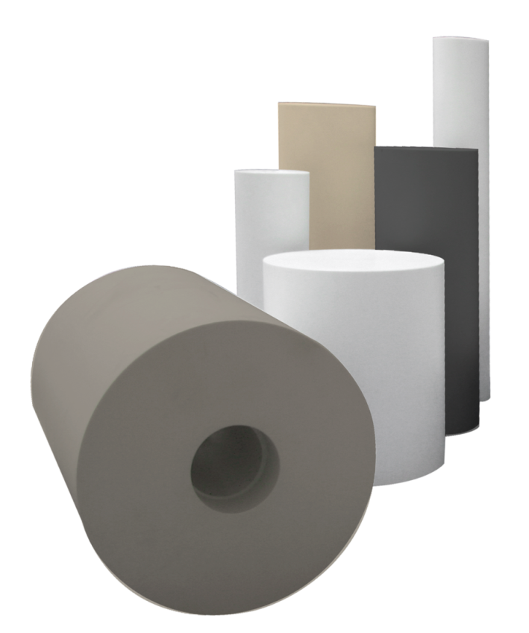

DELIVERY FORMS
Semi-finished products
ZEDEX® Semi-finished products are available
from stock in a wide range of dimensions.
Sheets
Rods & Tubes

Slide 11
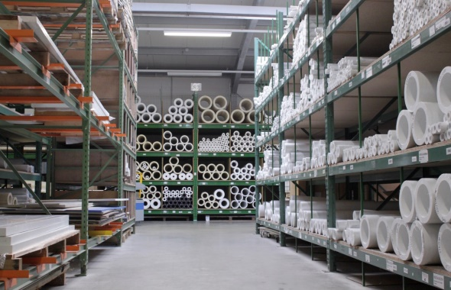
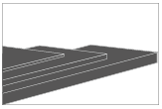
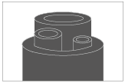

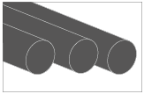

SEMI-FINISHED PRODUCTS
PLATES
Thickness from 6 up to 105 (mm)
width up to 1 meters
length up to 3 meters
Worldwide delivery
Anywhere you need it.
HOLLOW RODS
Outerdiameter
from 30 up to 380 (mm)
Innerdiameter
from 18 up to 300 (mm)
Standard length 1 or 2 (m)
Short delivery times
You need your components quickly? No problem for us.
RODS
Just-in-time
If something is not in stock, we produce it immediately.
Diameter from 6 to 210 (mm)

Slide 12
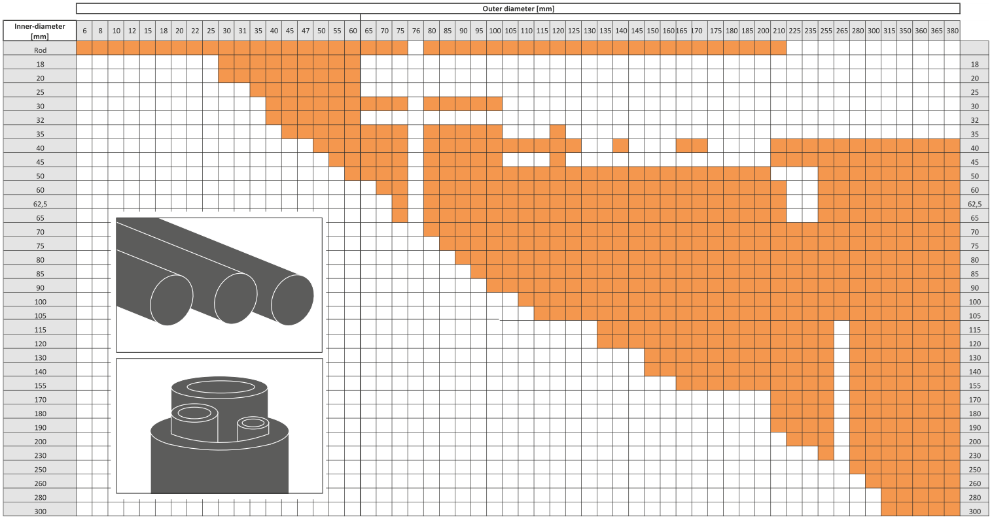
HOLLOW RODS / RODS DIMENSIONS

Slide 13
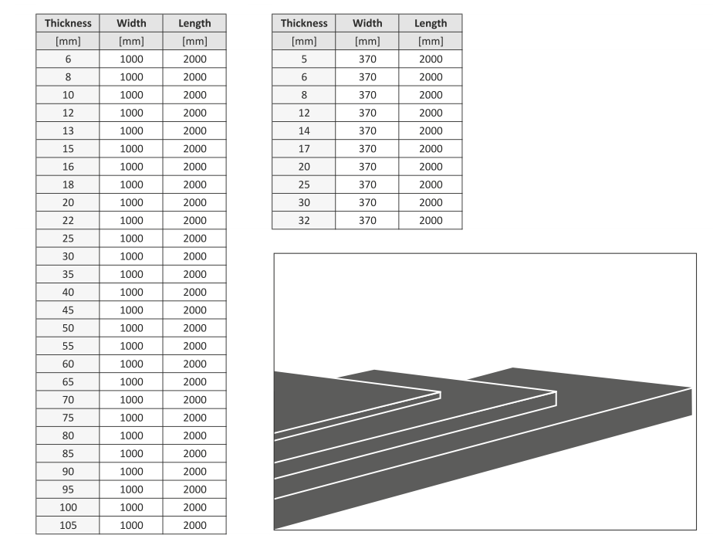
SHEET DIMENSIONS

Slide 14
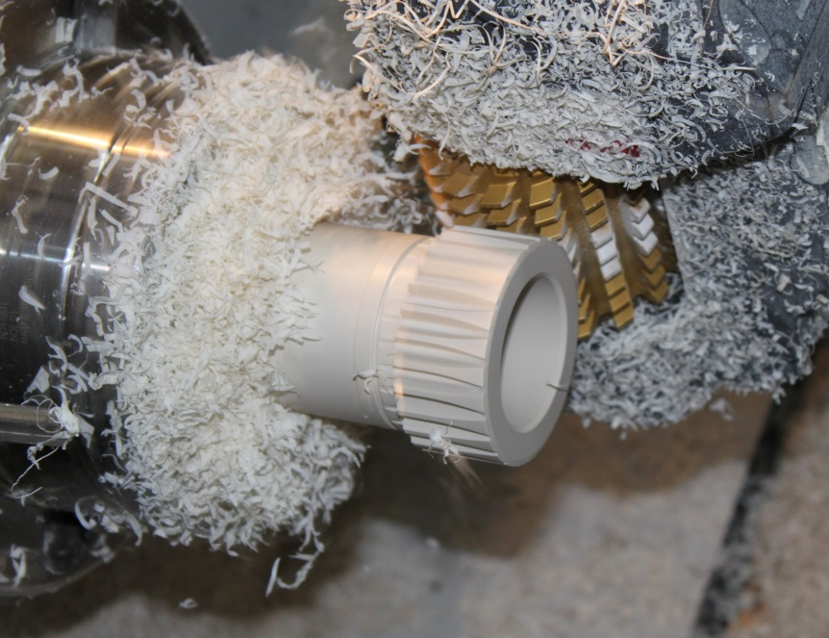
MACHINING
Automatic, partially unmanned production
From as little as 1 piece
Up to Ø 60 can be produced economically
at 5,000 pieces
Economical due to large range of tubes with fine dia. Graduation
Tolerances from ISO 6 possible.

Slide 15
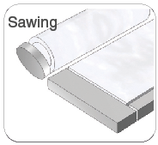
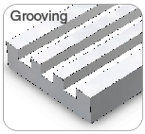
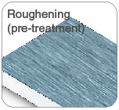
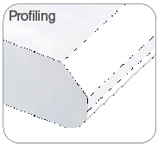
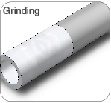
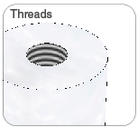
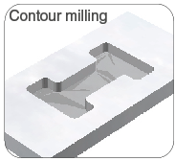
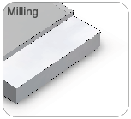
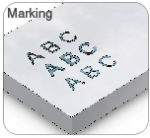
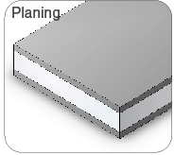
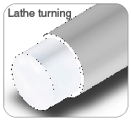
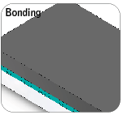
PROCESSING METHOD
We manufacture for you low-cost end products made of ZEDEX® polymers, always with the optimal procedure in relation to the quantities required. In our production we use the following procedures:
SAWING
GROOVING
ROUGHENING
(pre-treatment)
^{maximum Ø 600 mm}
^{maximum thickness 100 mm}
^{maximum width 1300 mm}
^{maximum length 3000 mm}
^{tolerance +5mm}
^{maximum thickness 100 mm}
^{maximum width 600 mm}
^{maximum length 800 mm}
^{tolerance ±0,05 mm}
^{Width < 1000 mm}
^{Thickness < 100 mm}
PROFILING
^{maximum thickness 100 mm}
^{maximum width 600 mm}
^{maximum length 800 mm}
^{tolerance ±0,05 mm}
GRINDING
centerless grinding from Ø 6 mm
^{to max. Ø 60 mm}
^{tolerance range 0,06 mm}
THREADS
All standard and special threads,
^{as well as threaded inserts}
^{(ENSAT/HeliCoil)}
CONTOUR MILLING
^{maximum thickness 100 mm}
^{maximum width 600 mm}
^{tolerance ±0,05 mm}
MILLING
^{4 axes:}
^{1270 x 510 x 635 mm}
^{5-Side-machining:}
^{800 x 500 x 600 mm}
^{5 axes:}
^{320 x 300 x 320 mm}
MARKING
^{Engraving from 2,5 mm,}
^{Silk-screen print from 5 mm,}
^{Inkjet from 10 mm}
PLANING
^{minimum length 400 mm}
^{maximum thickness 100 mm}
^{maximum width 600 mm}
^{tolerance ±0,1 mm}
LATHE TURNING
^{Ø < 75 mm Machined}
^{from bars with bar loader}
^{und high-powered tools}
^{Ø 60 – Ø 265 mm}
^{Turning step inner Ø < 1,0 m}
^{Turning step outer Ø < 1,8 m}
Turning conventional < Ø 585 mm
^{Turning length < 500 mm}
BONDING
^{Dosage: one or}
^{two-components adhesives}

Slide 16
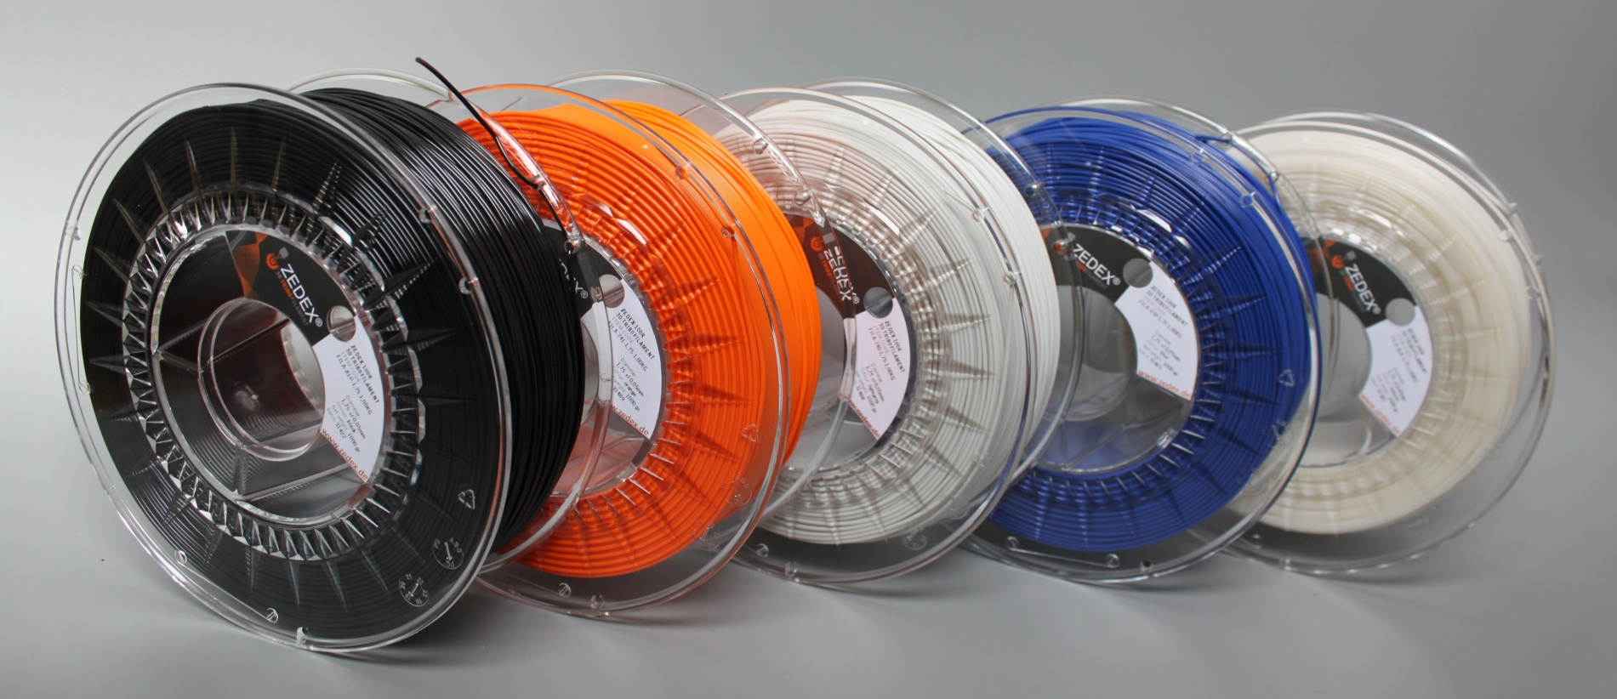

3D TRIBOFILAMENTS

Slide 17
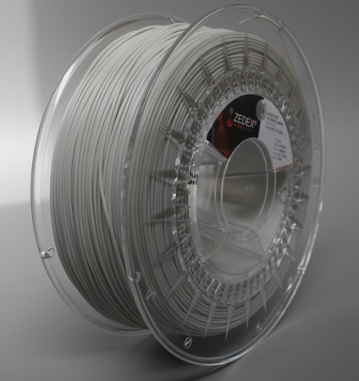
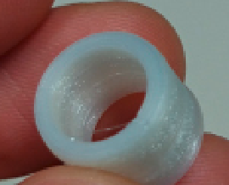
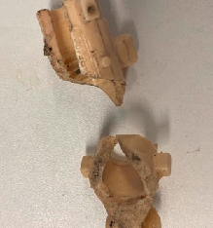
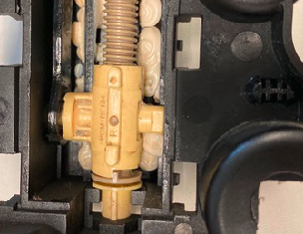
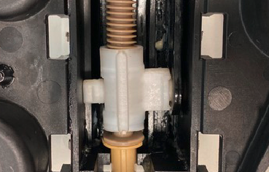
PRINTED TRIBO PARTS
3D-PRINTING WITH ZX-100
Printing speed: 50mm / s
Temperature: 280°C
Layer height: 0.2mm
In the future, parts made of high-temperature plastics
such as ZX-324, ZX-530, ZX-750 can be printed.
Filament Ø 1,75mm,
Tolerance +/- 0,03mm
3D printed bushing ZX-100

Slide 18
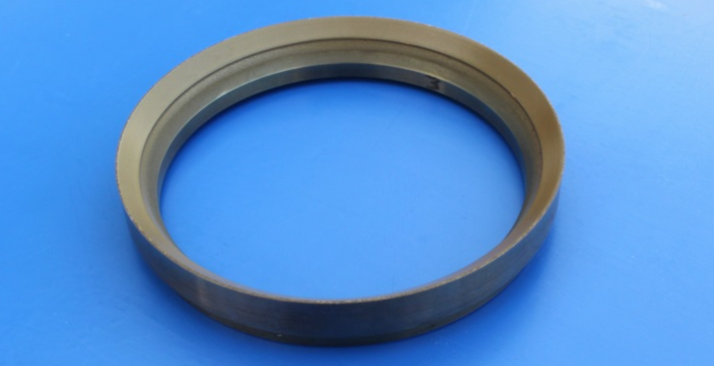
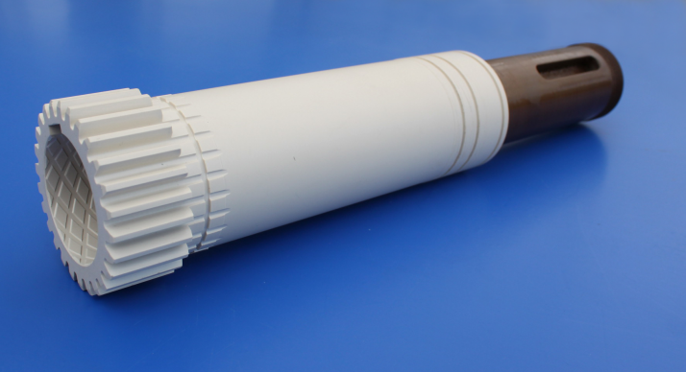
COATINGS ZEDEX® TRIBOCOAT
For coating metal parts using the airbrush method
or powder coating for the:
Improvement of tribological properties and Reduction of adhesion (bond)
to metal
Corrosion protection
Electrical and thermal insulation
Encapsulation of the base body against product and media contact
Improvement of the appearance of metal parts
Cost reduction, new process eliminates the need for overmolding or bonding
FDA compliant

Slide 19
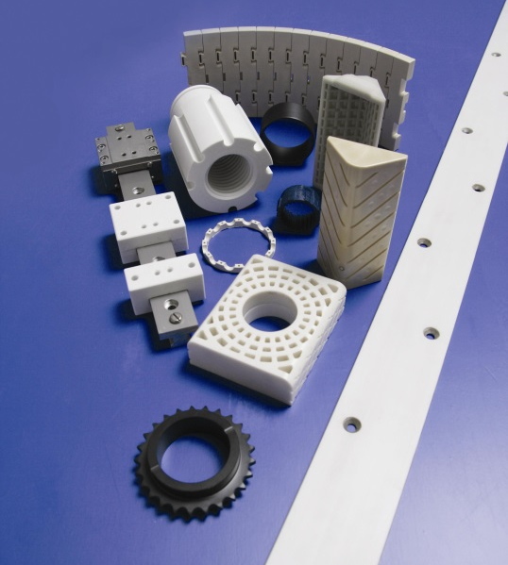
CUSTOMER SPECIFIC PARTS
ACCORDING TO CUSTOMER REQUIREMENT AND / OR DRAWING
Plain bearings (also hydrodynamic)
Movement nuts (also special profiles)
Slideway linings
Gears
Track rollers
Sliding rails
Bearing shells
Wipers
Metal-plastic composite parts
Plastic sheathing
general wear and insulation parts

Slide 20
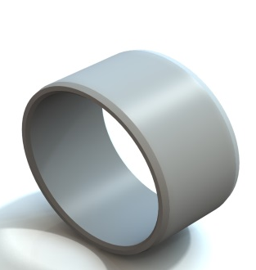
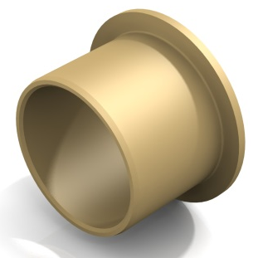
PRECISION PLAIN BEARINGS
CYLINDRICAL BUSHINGS
The dimensions of our plain bearings comply with
following DIN standards.
DIN 1850 - solid bushings as press-fit bushings in housings
DIN 1552 - for press-fit onto journals
DIN 1494 - rolled bushes as press-fit bushes
DIN 1498 - much thicker-walled than press-fit bushings
COLLAR BUSHINGS

Slide 21
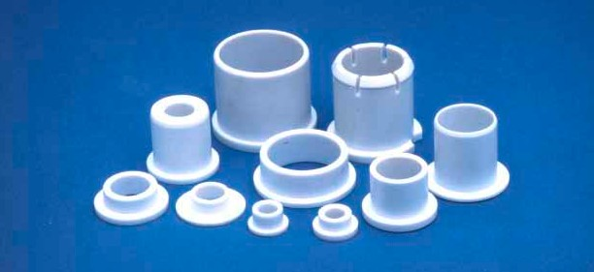

STANDARD PARTS
HIGH PRECISION BEARINGS
for dry running, oil, water lubrication
diameter 2 to 250 mm
MOVEMENT NUTS
with trapezoidal thread DIN 103
SLIDEWAY COVERINGS
with and without metal support
GEAR WHEELS
TRACK ROLLERS
FOIL BEARINGS

Slide 22


SLIDEWAY COVERINGS
Available in thicknesses from 1.5mm and formats
Adhesive surface pretreated
Optionally the suitable adhesive is available

Slide 23



FOIL BEARINGS
FOR PLAIN BEARING BUSHES
WITH LARGE DIAMETERS
By cold forming of plate strips made of ZX-100K
For large diameters with low wall thickness
Cost effective solution
For low operating bearing clearance, even with high temperature fluctuations
and / or
Simple mounting
Axial fixation necessary

Slide 24


SPECIAL MATERIAL FOR LARGE BEARINGS – PU CASTING
ZEDEX® Blue Water
Shore hardness D 68
For applications under Water and With abrasive particles
for predominant contact With water, max. 60 °C
available as semi-finished products With outer diameters
up to max. 725mm, 70kg
in future up to Ø 1200mm.
PU-PARTS FOR NON-WATER APPLICATIONS
for parts up to 2000 mm, 40kg
Track rollers
Reals
Bushings
Linings
Coatings
cam wheels
Anti-adhesive lining panels
for rubble
ZEDEX® Dirty Water
hard/soft-Composite, Dirty Water ist the inner side component
Shore D hardness 30
high wear resistence against abrasive particles for applications
With continuous water contact up to max. 60 °C
With or without axilal grooves available

Slide 25







APPLICABLE IN MANY SECTORS
SHIPBUILDING,
PORT, OFFSHORE
AGRICULTURE
CRANE AND BRIDGE CONSTRUCTION
OIL AND GAS INDUSTRY
FOOD INDUSTRY
CHEMICAL INDUSTRY
PROCESSING MACHINES
... and many other
specific industries.

Slide 26






















ALWAYS REACHABLE, EVEN ABROAD
Sale, prices
Laboratory
Shipment, delivery
Fon: 02273 - 9749 - 13
Fax: 02237 - 9749 - 43
E-Mail: sales1@zedex.de
Fon: 02237 - 9749 - 17
Fax: 02237 - 9749 - 20
E-Mail: labor@zedex.de
Fon: 02273 - 9749 - 16
Fax: 02237 - 9749 - 46
E-Mail: export@zedex.de
Application technology. Consulting
Quality assurance
Construction & Consulting
Fon: 02237 - 9749 - 26
Fax: 02237 - 9749 - 45
E-Mail: app@zedex.de
Fon: 02237 - 9749 - 63
Fax: 02237 - 9749 - 43
E-Mail: qmb@zedex.de
Fon: 02237 - 9749 - 39
Fax: 02237 - 9749 - 45
E-Mail: design@zedex.de
Would you like more information?
Then contact us by phone or in writing.
We will be happy to send you material free of charge, such as
e.g. material samples, various Reports and catalogs and much more.
ZEDEX® Worldwide
Contact details are also available for our representatives abroad.
Please contact us for a list.
Wolf Kunststoff - Gleitlager GmbH Heisenbergstr. 63 - 65
D-50169 Kerpen - Türnich Industrial park II
FON: 02237 / 97 49 – 0
FAX: 02237 / 97 49 – 20
EMAIL: info@zedex.de
WEB: www.zedex.de
www.3dtribofilament.de

